Slide 1
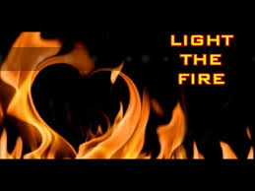
Today’s FFM: Thoughts and Questions!
I think… therefore I am”
What does Descartes believe?

Slide 2
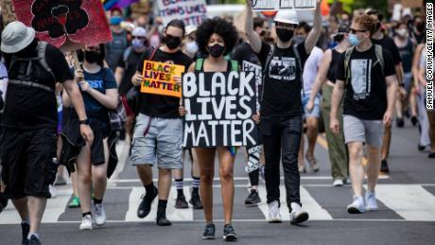
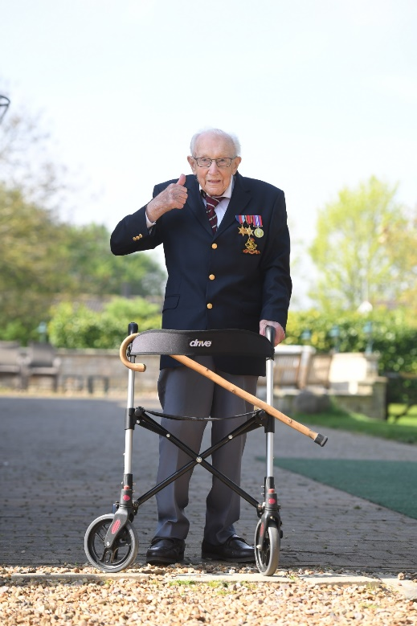
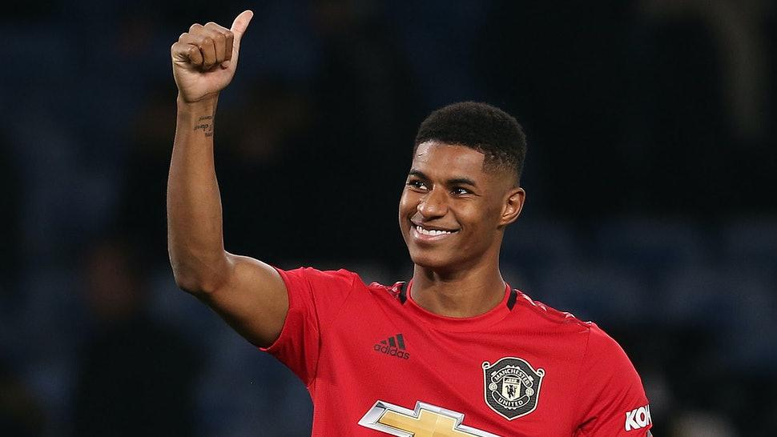
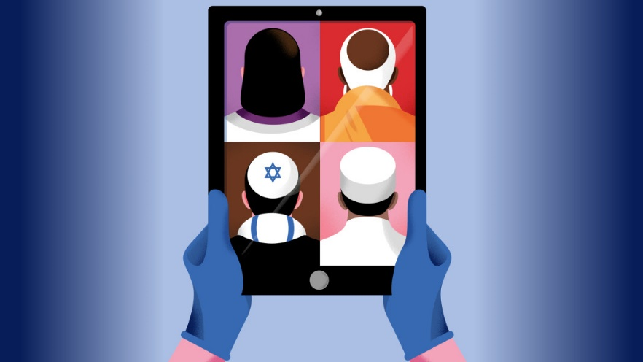
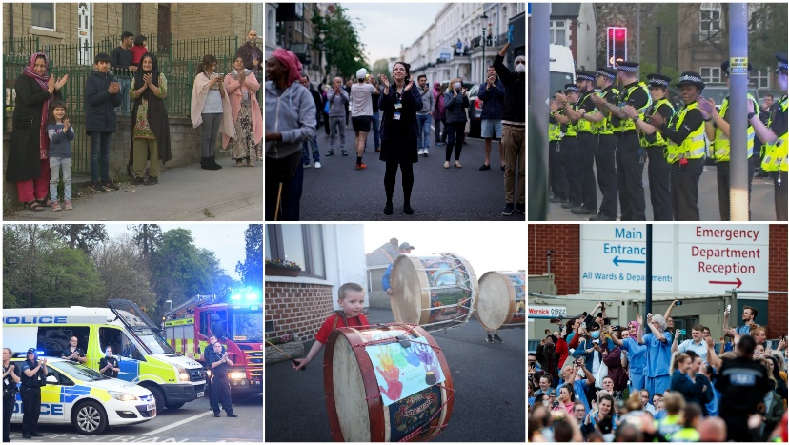

Thoughts and Questions?
A Pink Point Opportunity

Slide 3

Why Do We Study Religion and Worldviews?
Word Bank : Reflect; Interpret; Assess;
Complex; Society; Subjective; Rituals;
Empathy; Denominations

Slide 4

Think and Record
So why do we study Religion and Worldviews?

Slide 5


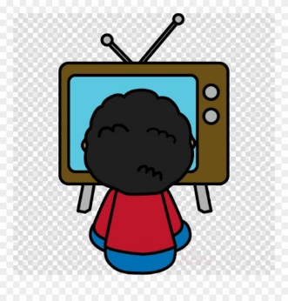
So why do we study Religion and Worldviews?
http://www.natre.org.uk/secondary/exploring-re-films/
Stretch : What Skills do you learn?

Slide 6

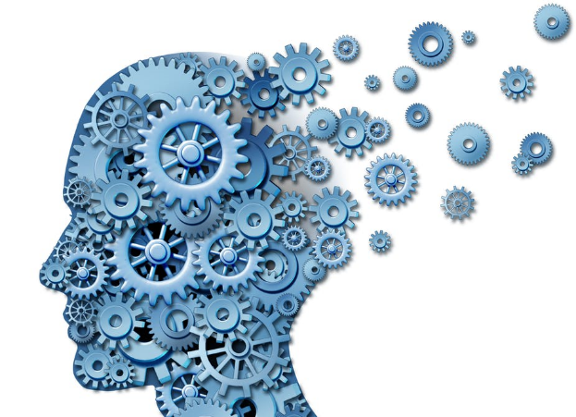

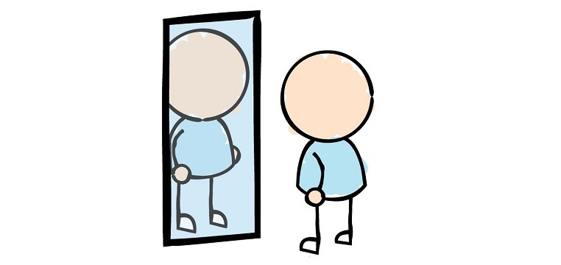

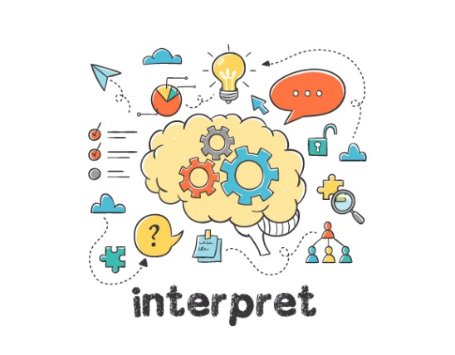
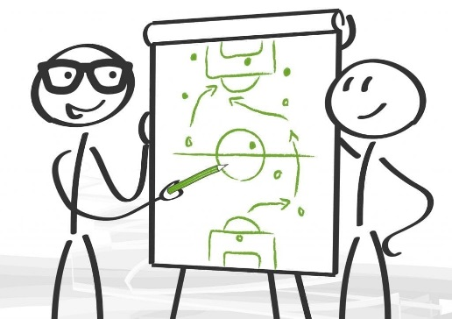
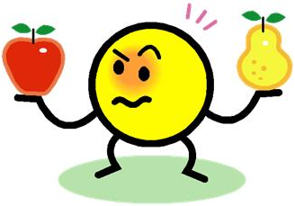
Know religious themes and world
views
Reflect upon key religious and world themes.
Question things around you
Think deeply
R.W. -SKILLS
Understand
Diversity and Individuality
Interpret
different beliefs and ideas
Demonstrate your learning in an academic way
Assess and link
different views and themes

Slide 7
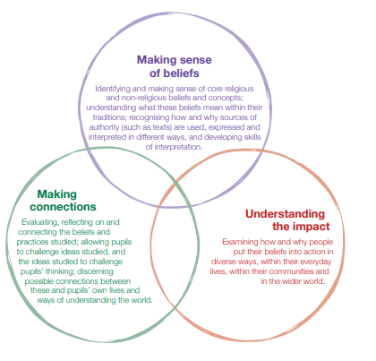
Context for open exploration of religion and belief

Slide 8
To Question
All humans have questions. When you are small, questions are very simple e.g What is ..? . As your questioning skills develop they become more complicated e.g how, why.
It is important to always ask questions as this is how we learn individually and as societies.
Just as engineers may try to answer the question “How can we build the fastest car?”
Religion and World views helps you to answer the various mysteries of life.
Can You list 5 complex questions
You would most like the answers too?
A Pink Point Opportunity

Slide 9


Questions !
What is this an image of?
So Is it:
Two white faces in conversation?
Two black bodies sat down back to back?
A bird bath?
A candlestick?
The Holy Grail?
Or can you think higher and deeper..
Could it be
something else?

Slide 10
To Think Deeply
RE is very subjective- This means different people have different ideas on what is right or wrong.
We want you to develop and question your opinions on a variety of religious and world views
Let’s Think More Deeply

Slide 11
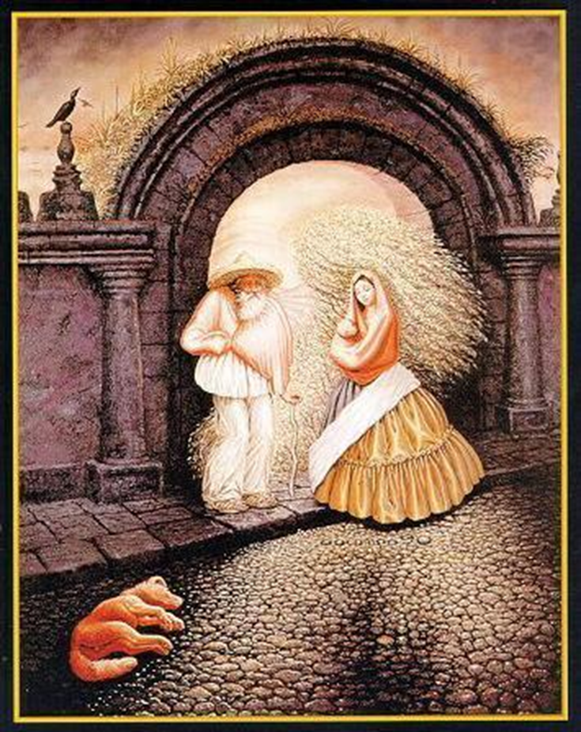
To Think
Deeply
There are at least 20 faces in this image- animals have faces and there are a number in the clouds-
How many can you see?
Can you find anymore?
A Pink Point Opportunity

Slide 12
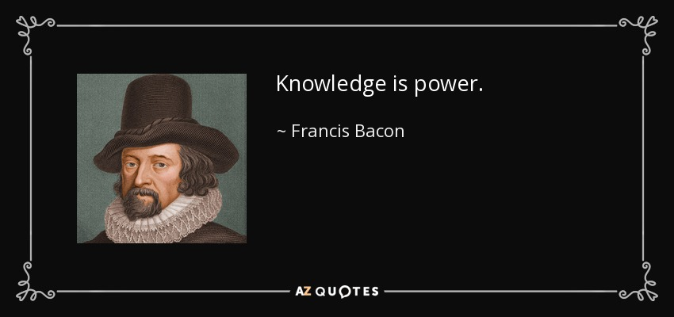

To Know
What does this quote mean?
Why is it important to know what other people believe and think?
A Pink Point Opportunity

Slide 13
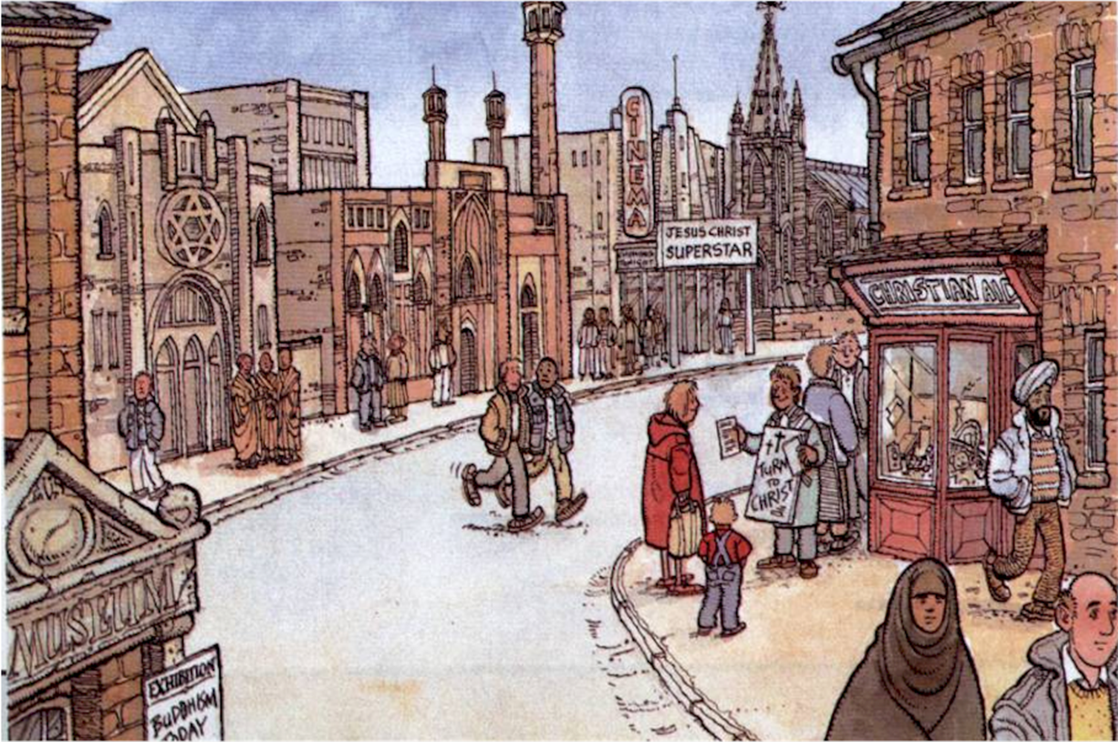
To Know
Which religious elements can you identify in the image?

Slide 14
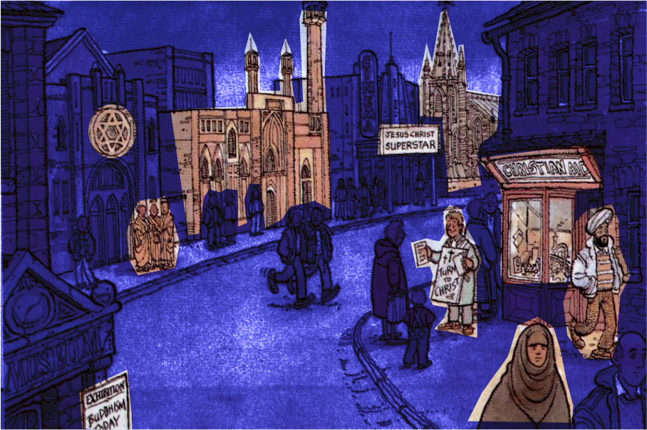

To Know
This building has a spire tower showing it’s a Church
This building has a minaret tower showing it’s a Mosque
This musical is about Jesus- the Messiah for Christians
Which religious elements can you identify in the image?
This shop is used to raise money by Christians to help the needy
Star of David- symbol shows this is a Synagogue
This person is teaching others about Jesus
This man is wearing a Turban which is usually a sign of Sikhism
These have shaved heads and robes of Buddhist monks
This person is wearing a hijab which is a sign of Islam
A Pink Point Opportunity
Buddhism is a religion

Slide 15
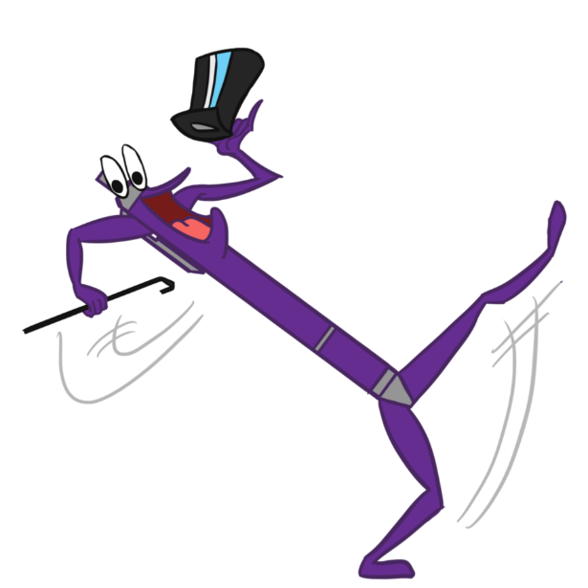
To Know
To truly understand other people, our community and the wider world we need to know what is important to them. By knowing other people they feel more comfortable in your presence, through knowing about our community we can improve it and knowing about the wider world will help prepare us for life in the future.
Some things we learn from our own experience, others from school and more from media- TV, film, music etc. To know something we usually have to learn it at least seven times before it passes to our long term memory.

Slide 16

To Reflect
Religion and Worldviews is not only about learning new things about others and the world, but also learning more about yourself.
Most faiths have a ceremony of commitment where you can declare your faith. This means anyone can join a religion if they go through the rituals.
Not everyone is religious but there is some truth in all religions. It is up to you to decide what is your truth.
You can also agree with some religious principles without belonging to a religion. You may believe in things such as the afterlife, but not have yet found the right explanation for you.

Slide 17

Key Question
Knowing things helps us to understand ourselves and others more.
Can you list as many reasons why this is important?
A Pink Point Opportunity

Slide 18
To Understand
Knowing things helps us to understand ourselves and others more. Understanding means being able to explain beliefs and behaviour, giving reasons.
In R &W we learn about others so we have better understanding of them and their experience.
Imagining ourselves in other’s experience is called empathy.
This skill is highly valued by any employment involving working with other people.

Slide 19
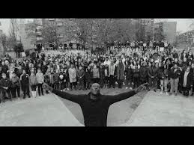
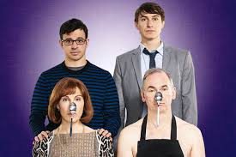
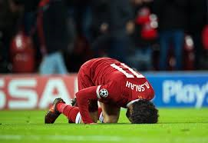
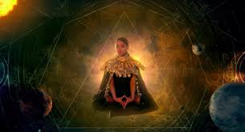
To Understand
He is “Blinded by your Grace”
They have their “Friday Night Dinner”
Religion and Worldviews will help you understand why…
He celebrates like this
She claims “God is not a man”

Slide 20
To Understand
He is “Blinded by your Grace”
They have their “Friday Night Dinner”
As a Christian he thanks God for his love and forgiveness.
As a Jewish family they honour God by having a special meal and thinking of him.
Religion and Worldviews will help you understand why…
He celebrates like this
She claims “God is not a man”
As a converted Kabbalist (Jew) she focuses on the essence of God not gender.
As a Muslim he thanks God for his gifts (of talent) and support.

Slide 21
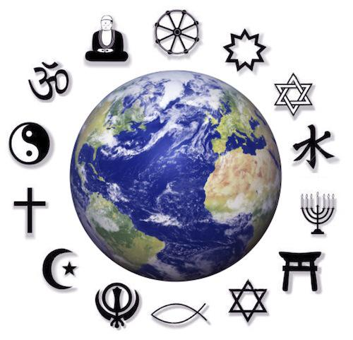
To Interpret
The reasons why religious and non religious people have their ideas and traditions can often be traced back to their religious teachings.
Each religion has its own version of history/law/stories etc. There are many overlaps but also crucial differences between them. There are also various ways these can be understood or interpreted.
Often there are significant differences within religions too- this causes the emergence of differing denominations.

Slide 22


To Interpret
Treat no others in ways that you yourself would find harmful.
The Buddha
Can you interpret the message from each of these religious quotes?
This is the sum of your duty; do not do to others what would cause pain if done to you.
Unknown. Hinduism
In everything, do to others as you would have them do to you, for this is the law.
Jesus
Not one of you truly believes until you wish for others what you wish for yourself.
Muhammed.
They all share the message: Treat others how you would like to be treated.”
This is known as the “Golden Rule” and is found in at least 13 religions.
A Pink Point Opportunity

Slide 23
To Assess
Religion and Worldviews allows you to consider and assess peoples experiences; holy books and teachings; religious leaders and world leaders views, both past and present. Also, you will consider various rules and laws.
On top of this you will also be able to include your own thoughts and extend your conscience
When you understand and know the reasons behind different arguments about something, you can start to weigh it up for yourself.

Slide 24
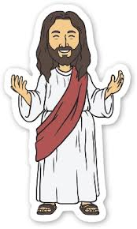

To Assess
Which idea do you agree with the most?
Why?
Jesus is the incarnation (Human form) of God and as such the son of God. He sacrificed himself to save all humans from sin. He rose from the dead, showing his power.
Jesus was an important teacher and good role model as he taught about caring for others and devoted his life to healing the sick.
Jesus was a criminal and trouble maker, the records show he vandalised the temple, caused a riot and was crucified.
Jesus was a prophet (messenger) of God who taught people how to be good, such as caring for others.
A Pink Point Opportunity

Slide 25



To Demonstrate
Thoughts, ideas, questions and feelings are all crucial to this subject. However they are hard to record, assess or monitor over time.
You can demonstrate what you know and understand through discussions, asking and answering questions, quizzes, homework, as well as written work in lessons.

Slide 26


Review/reflect…To Demonstrate
So Why Do We Study Religion and Worldviews?
A Pink Point Opportunity

