Slide 1


Today’s FFM – Show What You Know
A religious denomination is …
/what
Who are the Khalsa?
What is Enlightenment?
How do humanist’s explain the creation of the world?
Notes:
‹#›

Slide 2
Today’s FFM – Show What You Know
A branch of the religion .For example- Christian denominations incude Protestant and Roman catholic
A special community of initiated Sikhs
Understanding the truth about the way things are
The Big Bang theory
Theory of Evolution
Notes:
‹#›

Slide 3

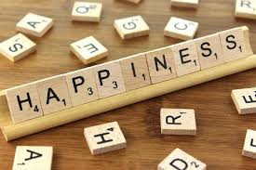
Should happiness be the purpose of life?
Title: What is Happiness?
Starter: Rank these activities in order of how important they as elements of happiness. 1 means most important.
Eating your favourite food
Visiting the dentist
Having fun with a friend
Helping a classmate
Watching a film
Playing a game
Discussing an interesting topic
Buying a new item of clothing

Slide 4

Why?
Explain why your number 1 is the most important thing for happiness.
I think that the most important thing for happiness is ..... because .....
Challenge: Is having fun the same as being happy? Can you have one without the other?

Slide 5
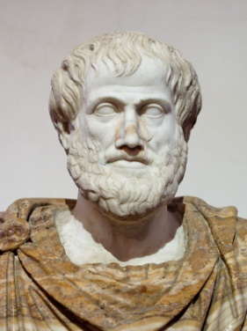
So what is happiness?
Aristotle, a famous philosopher said that happiness was ‘self-actualisation’ or living the best life you can live, being the best person you can be.
Is it a feeling?
Is it a thought?
Is it a state you are in?
How would you define happiness?

Slide 6
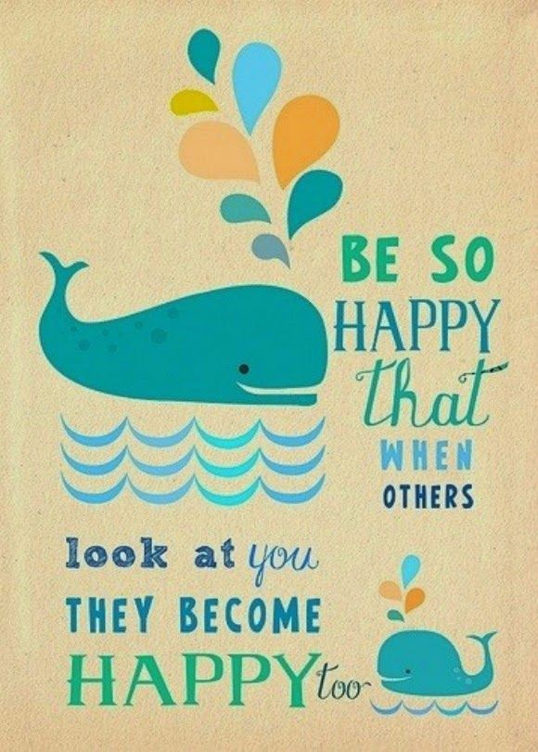
Is Happiness The Most Important Thing In Life?
Write down three goals that you have in life
What are you doing to make these goals a reality?
Will this make you happy?
Extension:
Why do you think that you have these goals? Where do they come from?
Goals:
To be a scientist
To earn lots of money
I am going to make sure these happen by…
I think this will make me happy because…
https://www.youtube.com/watch?v=qCWNXkzcKgo

Slide 7
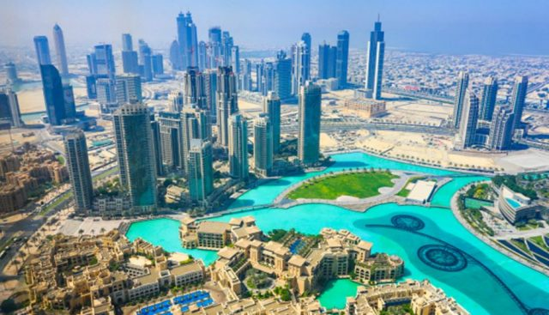

‘Money makes people happier’
Evaluate this statement.
Give arguments for and against
Use evidence from your table
Come to a conclusion
I agree/disagree... because.... My view would be supported by Professor Dunn/Fumio Sasaki/ a Telegraph article about using money to save time.......because......
Some people would disagree with me because... This view would be supported by Professor Dunn/Fumio Sasaki/ a Telegraph article about using money to save time.......because......
In conclusion.....

Slide 8
Does money make people happier?
Some people argue that money does not make people happier because ______________
________________________________________________________________________
________________________________________________________________________
This is supported by Professor Dunn who found that having less money makes you happier because you appreciate things more when you do have them.
However, some people argue that money does make people happier because ______
________________________________________________________________________
________________________________________________________________________
This is supported by an article in the Telegraph which showed that people who have money can pay people to do the jobs they do not want to do e.g. cleaning and this makes them happier.
In conclusion, I think that money does/does not make people happier because ________
________________________________________________________________________
________________________________________________________________________

Slide 9
Peer- Assessment
WWW
You have given two arguments to support your view
You have given two arguments against your view
You have used examples
You have developed your points
You have written your answer in paragraphs
You have written a conclusion
EBI
You should write two arguments to support your view
You should write two arguments against your view
You could use examples
You need to develop your points
Try to use paragraphs to structure your answer
Write a conclusion

Slide 10
‘The most important thing in life is happiness’
Agree | Disagree
Life should be about enjoyment and humans enjoy life the most when they are happy. | There are other things that are more important such as becoming educated . This might not always make you happy but it is important for new inventions and discoveries.
If people are happy then they are more likely to develop other skills such as kindness and generosity. | It is more important to defend the human rights of all people than to make most people in the world happy. Humans should focus first on providing shelter, food and healthcare to people living in poverty.
Create a picture for each of these arguments
What 5 keys words do you need to know about this topic?
Write another statement for each side
Which statement do you agree with and why?

Slide 11
So is happiness the most important thing in life?
Do you agree with the idea?
Can you build in that idea?
Can you challenge that idea?

