Slide 1

What does the Christian festival of Easter celebrate?
Can you list any forms of discrimination?
What does Diversity mean?
Who are the two main characters in the Christian Creation story?

Slide 2
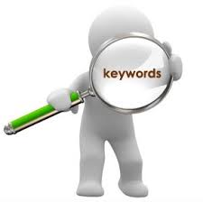
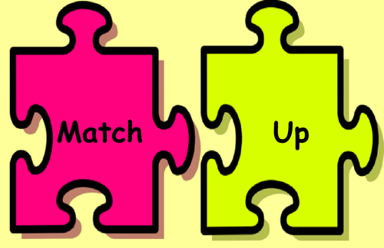
Key Words
 | Someone who is not sure whether god exists.
 | Someone who does not believe that god exists.
 | Something you feel is true but which you can not prove.
 | The holy book of Christianity made up of the Old and New Testaments.
 | An argument for the existence of God based on the idea that everything must have a cause.
 | The action or process of bringing something into existence.
 | A thing that is known and proven to be true.
 | Trust and confidence in something or someone.
 | The first book of the Bible.
 | In monotheistic religions, the name given to the spirit or being who is worshipped as the creator and ruler of the universe.
 | A view or judgement (not necessarily based on fact).
 | An organized system of beliefs, ceremonies, and rules used to worship a god or a group of gods
 | An argument for the existence of God based on the idea that the universe appears to have been designed.
 | Someone who believes in the existence of a god or gods.
 | Everything that exists

Slide 3


Key Words
Agnostic | Someone who is not sure whether god exists.
Atheist | Someone who does not believe that god exists.
Belief | Something you feel is true but which you can not prove.
Bible | The holy book of Christianity made up of the Old and New Testaments.
Cosmological argument | An argument for the existence of God based on the idea that everything must have a cause.
Creation | The action or process of bringing something into existence.
Fact | A thing that is known and proven to be true.
Faith | Trust and confidence in something or someone.
Genesis | The first book of the Bible.
God | In monotheistic religions, the name given to the spirit or being who is worshipped as the creator and ruler of the universe.
Opinion | A view or judgement (not necessarily based on fact).
Religion | An organized system of beliefs, ceremonies, and rules used to worship a god or a group of gods
Teleological argument | An argument for the existence of God based on the idea that the universe appears to have been designed.
Theist | Someone who believes in the existence of a god or gods.
Universe | Everything that exists

Slide 4
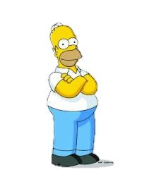
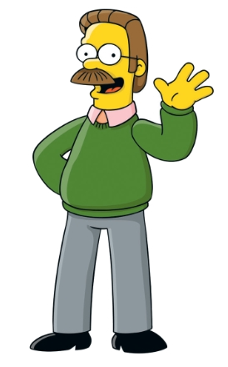
Initial ideas…
So why do some people believe in God and others don’t?
Reasons people do believe
Reasons people don’t believe

Slide 5

Where are you on the Scale of belief?
Why?
Agnostic
Atheist
Theist

Slide 6
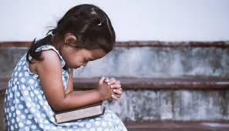
So why do some people believe in a god/gods?
A Theist’s perspective…
Watch the clip and then in pairs, discuss and record under sub-headings the reasons why a person choses to follow a religion?
https://www.bbc.co.uk/bitesize/clips/z9t4wmn
https://www.bbc.co.uk/programmes/p06myc0g

Slide 7

So why do some people believe in a god/gods?
A Theist’s perspective…
They have been brought up that way
They have experienced God – seen him, had a prayer answered
They have seen a miracle
They can see evidence that God exists in the world
They just know God exists (FAITH)

Slide 8
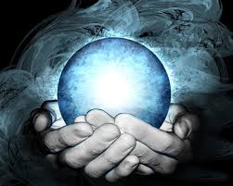
Key Thinking for Theists…..
God is All powerful?
This is known in religious circles as
Omnipotent
Why could religious people consider God to be omnipotent?
Another word for an really strong smell is potent!

Slide 9
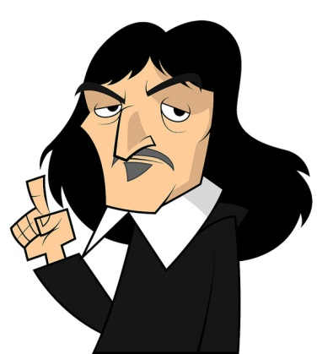
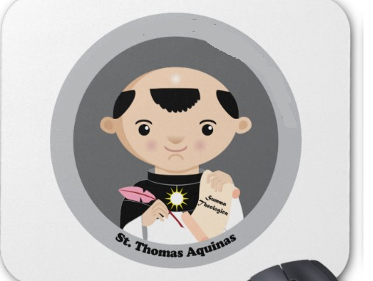
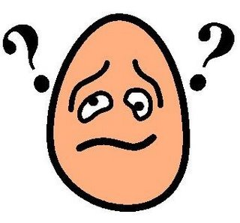
Omnipotence
The Philosopher Rene Descartes stated that God can/could do anything that he desired.
However St. Thomas Aquinas believed that there are something which God could not do.
‘Whatever implies contradiction does not come within the aspect of omnipotence, because it cannot have the aspect of possibility’.
What does Aquinas mean by this?

Slide 10

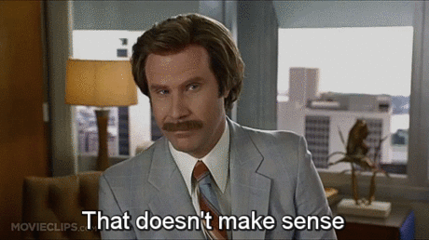
‘Whatever implies contradiction does not come within the aspect of omnipotence, because it cannot have the aspect of possibility’.
If it doesn’t fit any type of logical knowledge, it cant be seen as true.
How could this be seen through religion?
‘The God’s omnipotence must include of the Bible stands above the world as its sovereign Lord, its creator and its saviour; but he appears in the world to set men tasks to do, speaking to men in demand, in promise, in healing and fulfilment’
-John A. Hutchenson

Slide 11
‘The God’s omnipotence must include of the Bible stands above the world as its sovereign Lord, its creator and its saviour; but he appears in the world to set men tasks to do, speaking to men in demand, in promise, in healing and fulfilment’
-John A. Hutchenson
You have 2 minutes to write as many criticism of the omnipotence. Remember to be prepared to feedback!

Slide 12
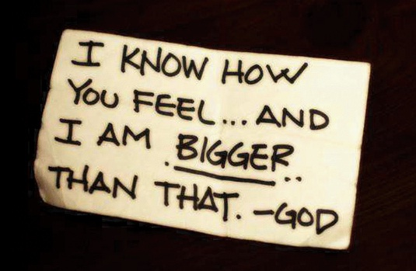
All powerful?
All knowing?
God?
Using religious logic, it must make sense that he would have to be all knowing!
‘If it snowed on 1st January 10 Million BC on the site of the present-day New York, God knows that it snowed there and then… All God’s beliefs are true and God believes everything is true’
- Richard Swinburne

Slide 13
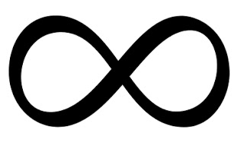
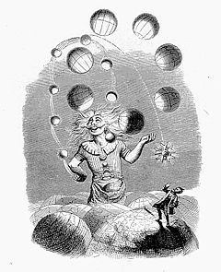
All knowing?
‘The lord was sorry that he made humankind on the earth and it grieved him to heart’
Genesis 6
Being that God created the world, in being at the moment of creation and have the knowledge to do so, it would suitably fit that he has the knowledge of all of his creation/s.
This is known as omniscient
Spells the start of Science!!!
Science= Knowledge

Slide 14
All loving?
The ‘vole’ can spell love!!!
This is known in religious circles as
Omni benevolence
Why could religious people consider God to be all benevolent?

Slide 15
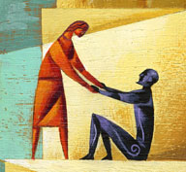
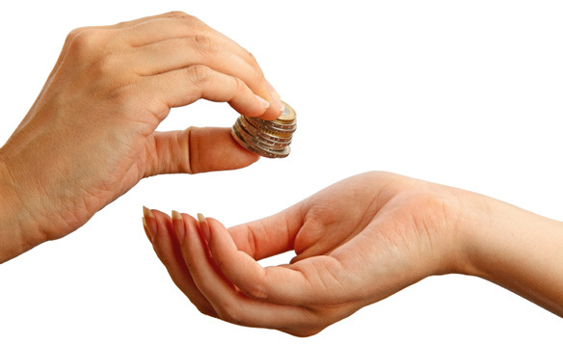
Which is the most loving duty?
Giving money to charity
Helping those in need
What religious people state about the lovingness of God is that it cannot, nor should not be measured in human standards.
Can you think of any examples to prove this is could be seen as right?

Slide 16
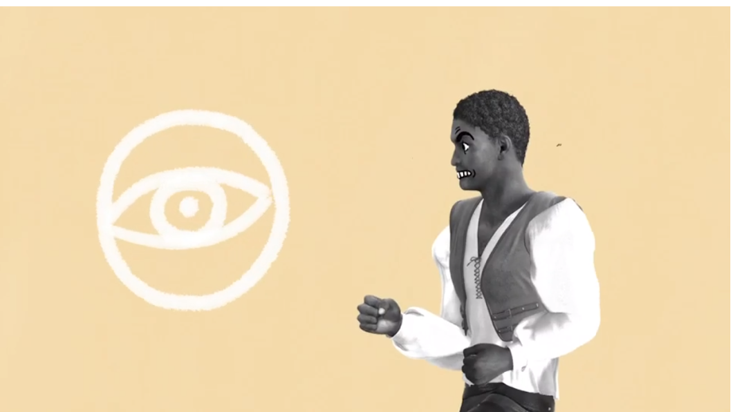
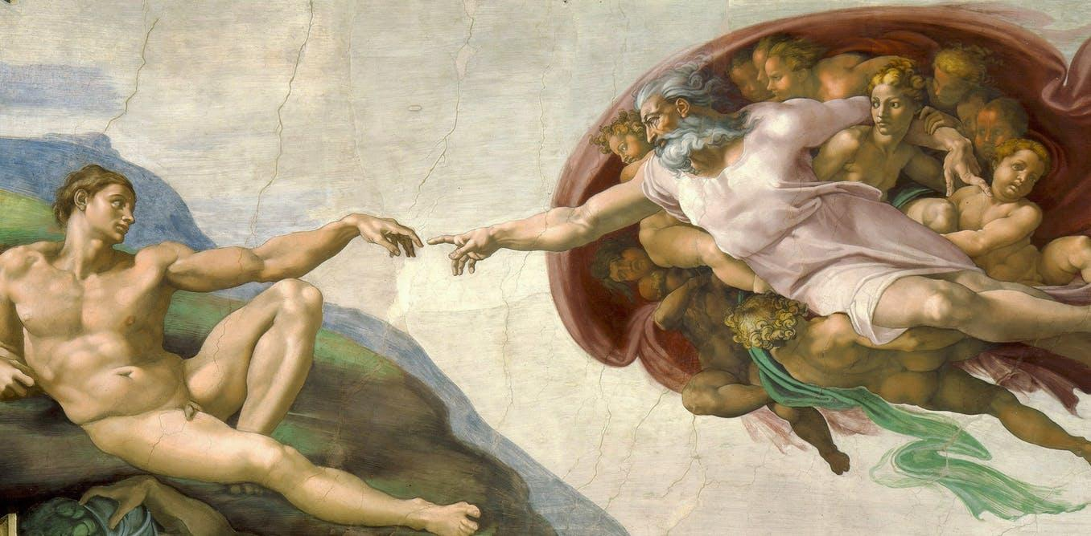
DISCUSS: So Which Omni does this show God being?...
Omniscient
Omnibenevolent
Omnipresent
Omnipotent

Slide 17
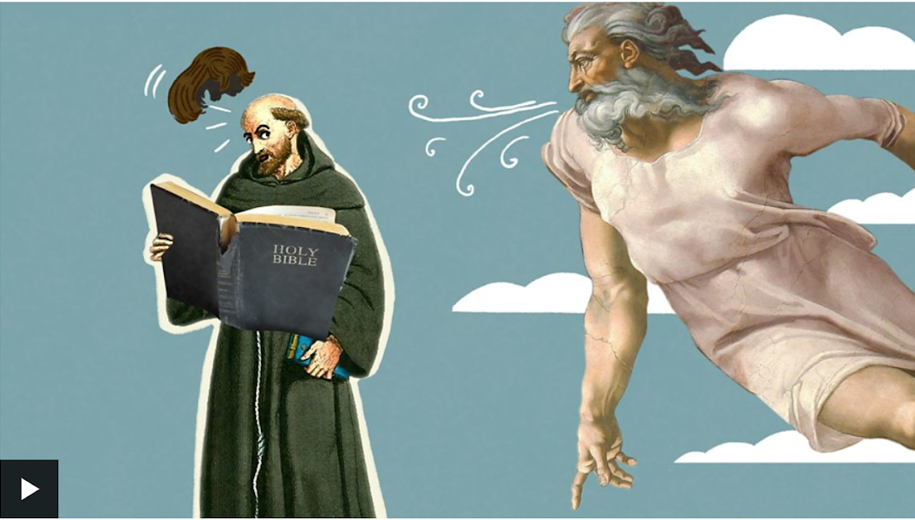
O is for… Omni’s
What is the difference between prayer and meditation
https://www.youtube.com/watch?v=xhjee6K2n28&safe=true
TASK: watch the clip and recap what the ‘omni’ words mean
https://www.bbc.com/teach/class-clips-video/religious-education-ks3-a-z-of-religion-and-beliefs-0-is-for-omnis-power-of-god/zjgv47h
Notes:
https://www.bbc.com/teach/class-clips-video/religious-education-ks3-a-z-of-religion-and-beliefs-0-is-for-omnis-power-of-god/zjgv47h– 0 is for omni’s

Slide 18
What is the teleological argument?
Spellings
1.
2.
3.
Explain what an Atheist believes.
In which book of the Bible tells the story of creation.

Slide 19
What is the teleological argument?
Spellings
1. Omnipotence
2. Theist
3. Discrimination
Explain what an Atheist believes.
In which book of the Bible tells the story of creation.

Slide 20
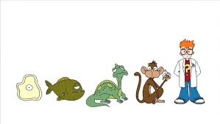
How do Theists prove God exists?
https://www.truetube.co.uk/film/proving-god-exists

Slide 21
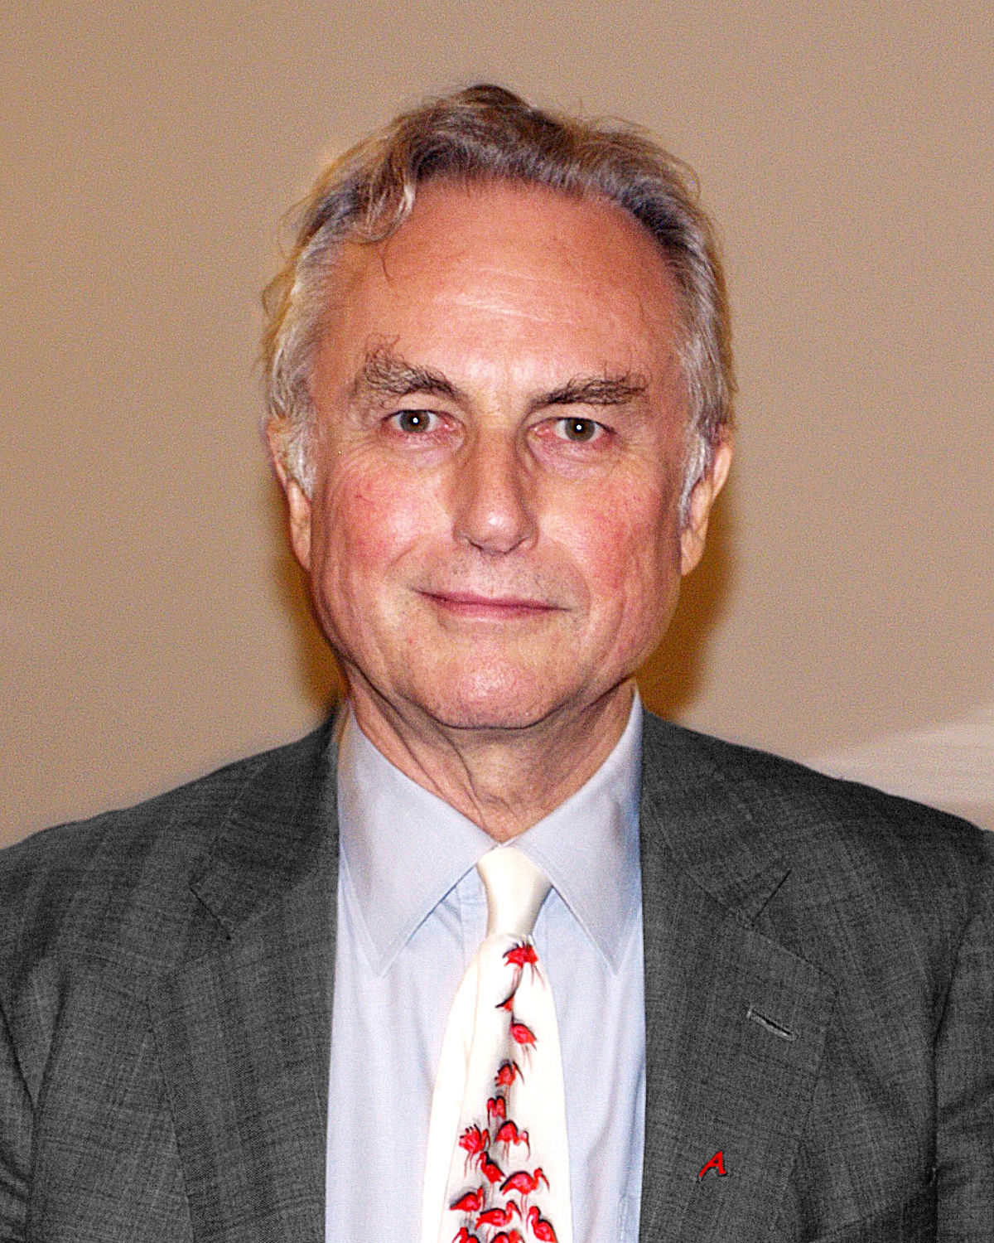
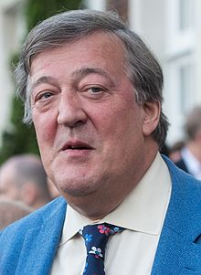
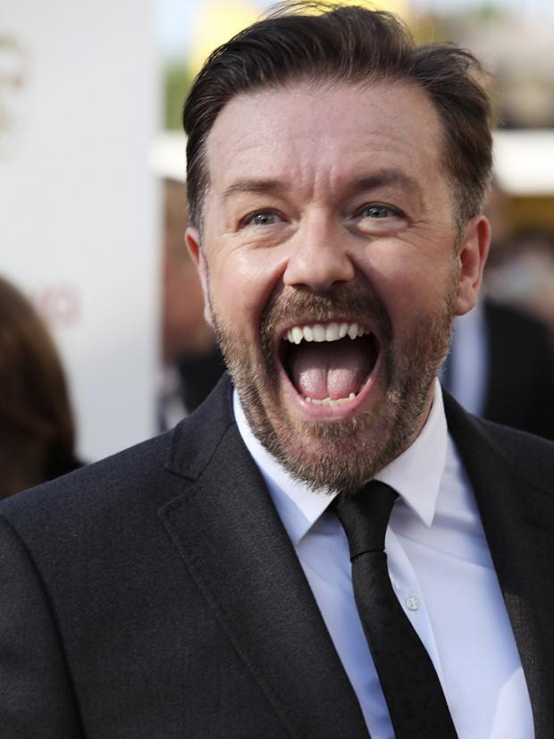
Who are these people?
What links them?
Stephen Fry is a famous presenter, actor and writer.
Ricky Gervais is a famous comedian and writer
Richard Dawkins is a famous evolutionary biologist and has written books called The God Delusion and The Selfish Gene.
They are all atheists! This means they don’t believe in God.

Slide 22
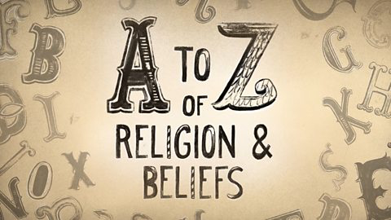
So why do some people chose not to believe in a god/gods?
An Atheist’s perspective
Now watch the episode…
https://www.bbc.com/teach/class-clips-video/religious-studies-ks3-a-is-for-atheism/zdkcwty

Slide 23


T.I.F…Humanism is a non-religious philosophy that is based on human values.
Watch the clip https://www.youtube.com/watch?v=9tpL1K8ZqrU
In pairs - read, discuss and make notes on ‘the unanswered prayer’
https://www.truetube.co.uk/film/what-humanism
Notes:
https://humanism.org.uk/humanism/ 3 mins an alternative clip

Slide 24
So What is Humanism?
Humanists believe we have one _________ which should be enjoyed and lived to the full.
2. Humanists base their understanding of the world on ____________and experience, not on religion and ____________ .
3. Humanists take responsibility for their actions and decisions and suggest we can lead good lives without recourse to gods, sacred texts and other beliefs for which there is no proven, scientific or ______________ basis.
4. Humanists recognise that moral values are founded on ____________ nature and experience alone.
REASON-SUPERSTITION- LIFE-RATIONAL-HUMAN

Slide 25
So why do some people chose not to believe in a god/gods?
An Atheist’s perspective…
There is no evidence
There are scientific explanations for the world
There are too many bad things in the world – would God make people suffer?
Prayers aren’t always answered

Slide 26

God?
Omni Benevolent
Omniscient
Omnipotent
Using this video;
Bullet point as many criticisms as possible for this definition.
http://www.youtube.com/watch?v=cv85tvudi7Y&safe=active

Slide 27
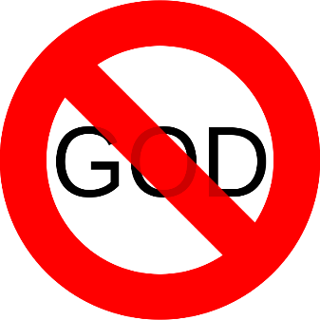

“The best thing that God can do for human beings is to let them doubt his existence.”
Do you agree ?
Give reasons for your answer, showing you’ve thought about more than one point of view.

Slide 28


“The best thing that God can do for human beings is to let them doubt his existence.”
Do you agree ?
Give reasons for your answer, showing you’ve thought about more than one point of view.

Slide 29
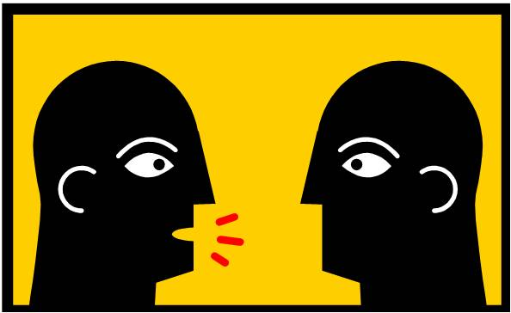
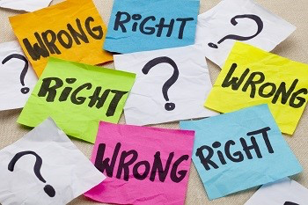
Discussion point
What is different about the ways in which religious and non-religious people make decisions?
Is one way easier than the other?
Remember be prepared to feed back
Religious decisions are guided by:
Free Will guides choices
10 commandments
4 noble truths
Eightfold Path
Stretch : Is it fair to say that atheism is a faith?

Slide 30
What does a theist believe?
Spellings
1.
2.
3.
EXPLAIN the
Free Will Argument.
In which book of the Bible tells the story of creation.

Slide 31
What does a theist believe?
Omnipotent
Omnibenevolent
Omniscient
EXPLAIN the
Free Will Argument.
In which book of the Bible tells the story of creation.

Slide 32
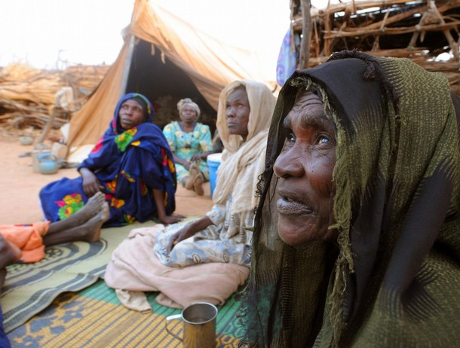

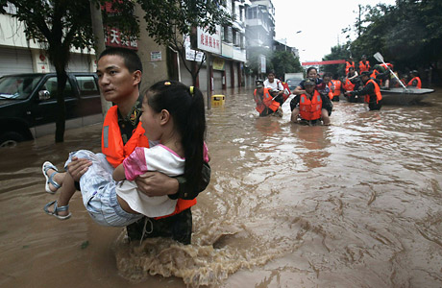
The Problem of Evil and Suffering
LO: To understand what is meant by the terms evil and suffering
To explain the difference between moral and natural evil
To evaluate how the existence of evil and suffering in the world may lead to reject a belief in God

Slide 33


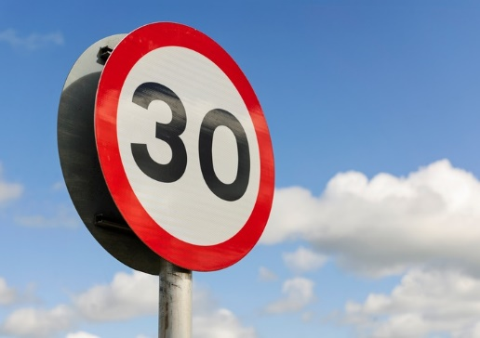
Can you define in no more than 30 words each:
Evil:
Suffering:
Notes:
2 minute timer

Slide 34

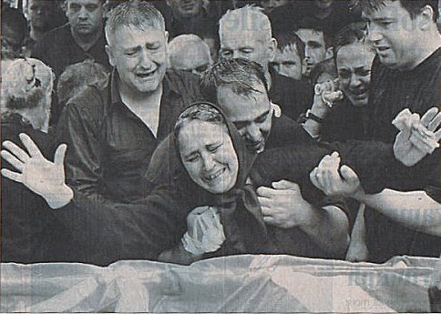
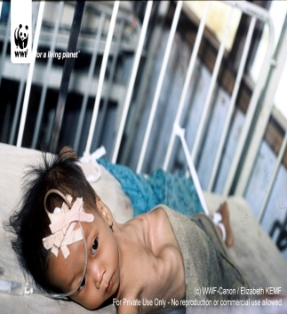
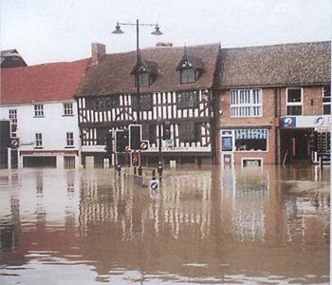
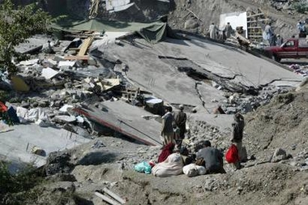
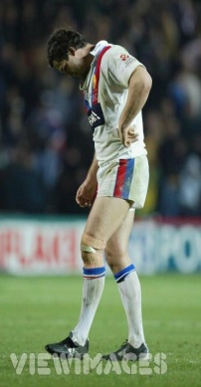
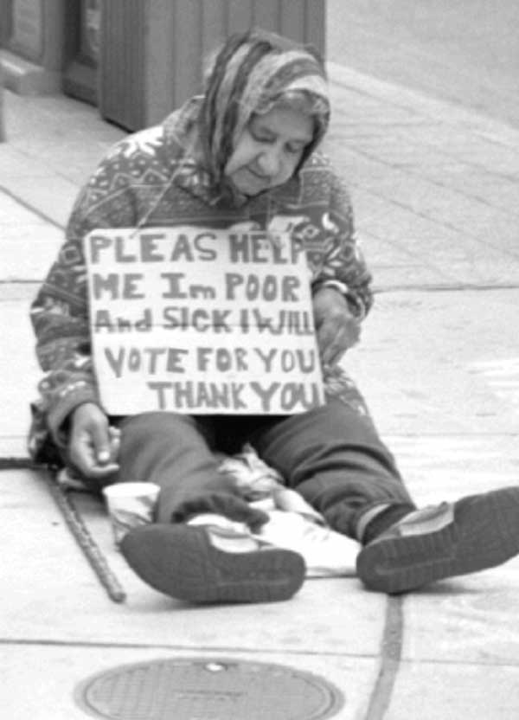
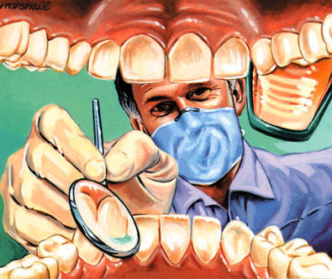
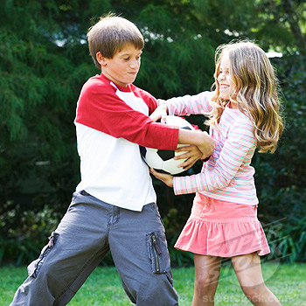
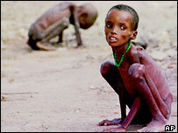
Reasons for Suffering
Shows the most suffering
A
B
C
Shows the least suffering
D
E
F
F
Using your diamond grid, rank the suffering from most to least.
Then say why you chose each one at the bottom of the page.
Example. “I chose D because if my home had been destroyed in an earthquake I would have nowhere to live.”
G
H
I

Slide 35
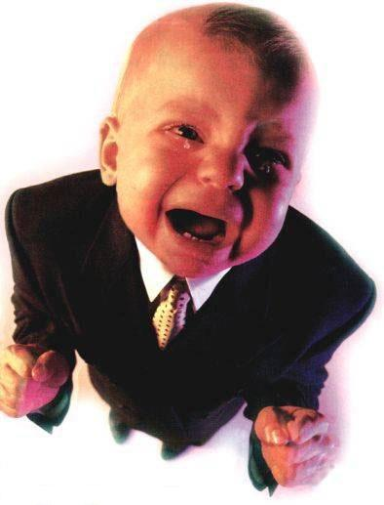

It’s not fair!
Write two or more examples of something you think is unfair in the world.
Be prepared to

Slide 36

Copy and Complete….
Moral evil: Suffering caused by humans.
Natural Evil: Suffering due to natural causes
Next …
List THREE examples of moral evil and THREE examples of natural evil.

Slide 37
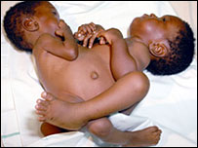
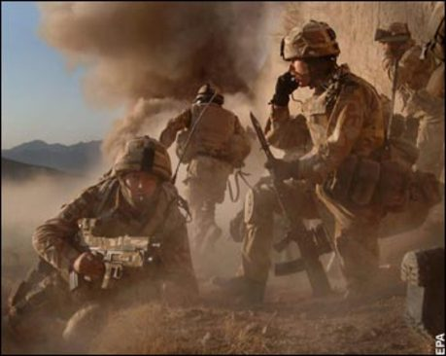
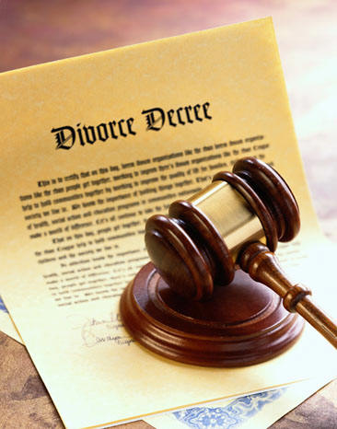
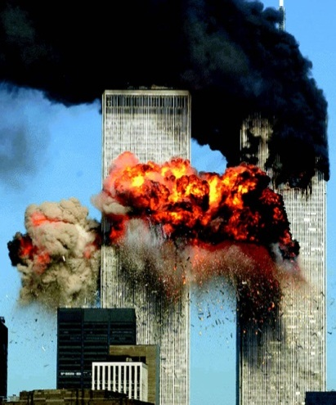
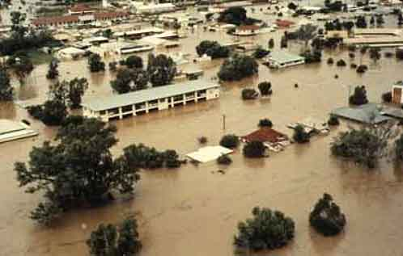
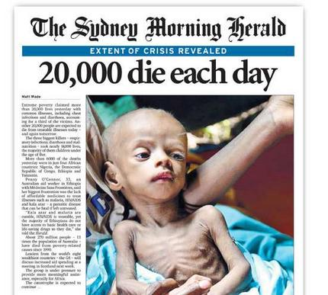
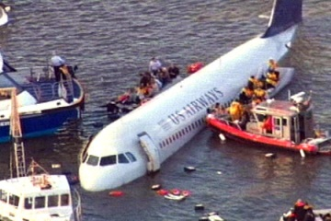
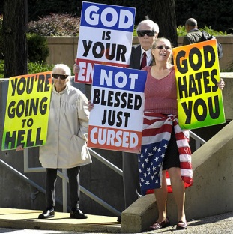
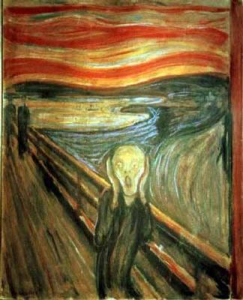
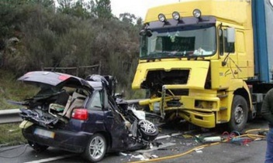
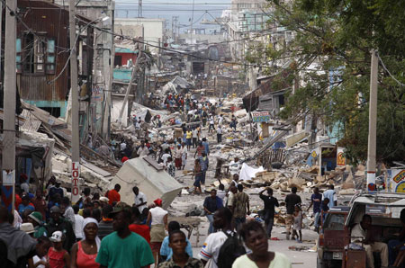







1.Which ones are moral evil?
4.Which are results of unanswered prayer?
3.Which ones are reasons for not believing in God?
2.Which ones are natural evil ?
Notes:
What kinds of evil & suffering can you see here (natural or moral)
Which are reasons that people give for not believing in God?
Which are reasons for unanswered prayer?
Which ones are God’s fault?
Famine – terrorism – war – family conflict – divorce – pain -

Slide 38

You Decide….
m
Along 1 line number 1 to 10 leaving space in between each number .
Next, decide whether the following pictures are examples of moral or natural evil.
Moral Evil
n
Natural Evil
To know the difference between moral and natural evil and consider how the existence of evil and suffering in the world may lead to reject a belief in God.

Slide 39

To know the difference between moral and natural evil and consider how the existence of evil and suffering in the world may lead to reject a belief in God.

Slide 40

To know the difference between moral and natural evil and consider how the existence of evil and suffering in the world may lead to reject a belief in God.

Slide 41


To know the difference between moral and natural evil and consider how the existence of evil and suffering in the world may lead to reject a belief in God.

Slide 42






To know the difference between moral and natural evil and consider how the existence of evil and suffering in the world may lead to reject a belief in God.
https://www.youtube.com/watch?v=gwyqT7rcCYk&list=PLqq-J7pqsr1yPaq7EY8p3Pe0VTt_HLg62&index=25

Slide 43

To know the difference between moral and natural evil and consider how the existence of evil and suffering in the world may lead to reject a belief in God.

Slide 44











Mass Murder
To know the difference between moral and natural evil and consider how the existence of evil and suffering in the world may lead to reject a belief in God.

Slide 45

To know the difference between moral and natural evil and consider how the existence of evil and suffering in the world may lead to reject a belief in God.

Slide 46





To know the difference between moral and natural evil and consider how the existence of evil and suffering in the world may lead to reject a belief in God. https://www.youtube.com/watch?v=IDjLIJH5MIg

Slide 47



Slide 48






Slide 49

Give three examples of a moral evil.
Three examples of moral evil are………
To know the difference between moral and natural evil and consider how the existence of evil and suffering in the world may lead to reject a belief in God.

Slide 50

Give three examples of a natural evil.
Three examples of natural evil are…….
December 26, 2004 Tsunami
To know the difference between moral and natural evil and consider how the existence of evil and suffering in the world may lead to reject a belief in God.
Notes:
Tsunami has you tube imbed – click picture

Slide 51


Point….
What is an atheist?
What is an agnostic?
What is a theist?
What are the 4 Omni- keywords?
To know the difference between moral and natural evil and consider how the existence of evil and suffering in the world may lead to reject a belief in God.

Slide 52

How might the existence of evil and suffering lead people to reject a belief in God?
Remember to use examples of Moral Evil e.g you could use the Holocaust, Rwanda, 9-11.
Also examples of Natural Evil e.g you could use a Tsunami , the floods to illustrate your answer.
Also the Omni-…. Keywords

Slide 53

How evil and suffering can cause people to question or reject a belief in God
Moral Evil
Natural Evil
To know the difference between moral and natural evil and consider how the existence of evil and suffering in the world may lead to reject a belief in God.

Slide 54
How might the existence of evil and suffering lead people to reject a belief in God?
Remember to use examples of Moral Evil e.g you could use the Holocaust, Rwanda, 9-11.
Also examples of Natural Evil e.g you could use a Tsunami , the floods to illustrate your answer.
Also the Omni-…. Keywords

Slide 55

What do Christians believe about God?
All powerful
Vengeful
Loving
Angry
Eternal
Creator
Limited
All knowing
Looking at your answers plus the above-
What questions might a Christian want to ask God about suffering and evil?

Slide 56

HOW TO REMEMBER…?
Christians believe that the story of Adam and Eve help them to understand why evil and suffering occurs on the Earth.

Slide 57

ORIGINAL SIN
The FIRST ever SIN.
A sin inherited by all descendants of Adam.
Adam and Eve committed the original sin when they ate the forbidden fruit in the Garden of Eden.

Slide 58
ORIGINAL SIN
Original Sin
Watch the following clip.
How many of the 8 Christian explanations for evil and suffering can you spot?
https://www.truetube.co.uk/film/beginning

Slide 59
ORIGINAL SIN
Sub Heading: Original Sin
Write the following headings and leave 5 lines between each.
TEST of FAITH
PUNISHMENT
FREE-WILL
THE DEVIL
Now give an example of each from the story.

Slide 60

TEST OF FAITH
God tests Adam and Eve’s FAITH by asking them to follow His rules without questioning Him.
By putting the tree in the garden God is testing their FAITH.

Slide 61

PUNISHMENT
Adam and Eve are PUNISHED for going against God (committing SIN).
The serpent is PUNISHED for tempting Adam and Eve.

Slide 62

FREE-WILL
Adam and Eve are given the FREEDOM from God to CHOOSE whether to obey Him or to break His commands.

Slide 63


THE DEVIL
The DEVIL appears as the SERPENT and tempts Eve to break God’s commandment.

Slide 64

What do you think?
Do the responses you have looked at today solve the problem of evil and suffering for theists?
Look at each Christian response individually…

Slide 65

PLENARY…
Guess the Christian response to evil and suffering from the picture shown

Slide 66

The Story of Job
Lesson Objective: to understand what the story of Job teaches about suffering.

Slide 67
The Book of Job is in the Old Testament in the Bible
The Book of Job says that we don’t know why God does everything He does...
Job

Slide 68

Meet Job:
BIO
Lives: Uz
Family: Wife – x7 Sons & x3 Daughters
Livestock: 7000 Sheep, 3000 camels, 500 Oxen, 500 Donkeys.
Servants – Lots of them!
Job + God = good terms.
He had it ALL.

Slide 69

Then one day...
God and Satan decide they are going to put Job’s faith to the test. Will Job stay faithful to God?

Slide 70

At this point the Devil is certain that he will get one over on God, and that Job will turn his back of God. A true test of faith.

Slide 71

Job’s animals are killed or captured by his enemies.

Slide 72

Job then, lost his children through a mighty wind that swept in from the desert, destroying their home and crushing them to death.

Slide 73

Things couldn’t get much worse for Job, he has lost everything. He strips himself of his clothing to prove that he still has faith in. He did not blame God.

Slide 74

God and Satan persist in their wager, and decided to test Job even more. They inflict painful sores all over Job’s body.

Slide 75

His Wife was mad...

Slide 76

His friends doubt Job, and think that he must have sinned in order to experience so much suffering.

Slide 77

Then God speaks...
He refuses to explain why he caused Job so much pain and suffering.

Slide 78

God decides that enough is enough
and restores Job’s wealth...

Slide 79

And his livelihood...

Slide 80

And his children...

Slide 81

Job lived a long and happy life until he was 140 years old!

Slide 82

Check your understanding...
.
Write a summary tweet – which explains the moral of the story?
What does the story tell us about suffering?

Slide 83

The Freewill defence
When God made humans he did not want us to be like puppets on strings, only doing what he wanted.
So instead he made humans to have a choice; to chose how we want to behave.
Basically he wanted us to have the FREEDOM to be Good or Bad.

Slide 84
How do Christians respond to the problem of evil and suffering?
Book of Job – we cannot understand everything that God does
God wants to help those who suffer.
Evil and suffering are not God’s fault – free will.
All part of God’s plan – those who suffer will be rewarded by eternal paradise after they die.
We cannot understand the reasons why God chooses to do or not do certain things.

Slide 85

Can you define?

Slide 86
Our Father, who art in heaven, hallowed be Thy name, Thy kingdom come, Thy will be done on earth as it is in heaven. Give us this day our daily bread; and forgive us our trespasses as we forgive those who trespass against us; and lead us not into temptation, but deliver us from evil. For thine is the kingdom and the power and the glory forever and ever. Amen.

Slide 87
“Prayer and acceptance are the best ways to deal with evil and suffering”
Debate

Slide 88
“Prayer and acceptance are the best ways to deal with evil and suffering”
Debate

Slide 89


#FTM…
Gimme five facts you have learnt today..
Then swap and add a fact from your partner
WWW: Name 2 things you have done well.
EBI: Name 2 things you would like to improve

