Slide 1
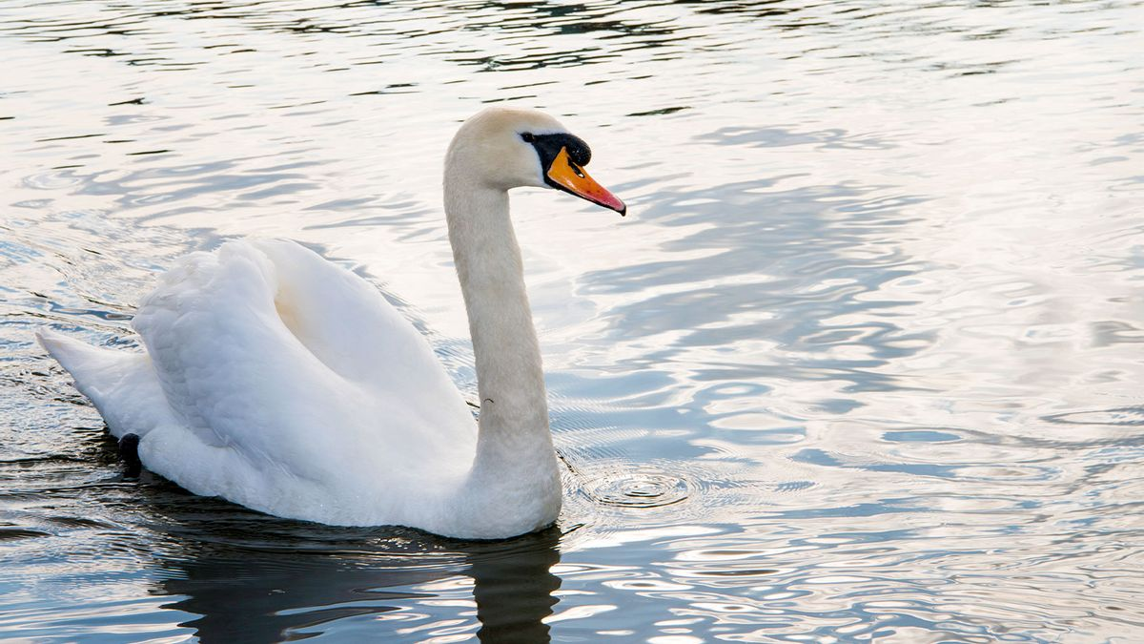
Wednesday, 18 January 2023
TITLE: Metta & Karuna
Name 2 Christians festivals | Name the 2 traditions (groups) Buddhists can belong to | Name the keyword for Jesus dying on the cross
Explain why the Buddha left the palace | What is a pilgrimage? | Define the word dukkha
What is nuclear diasarmament? | Name 2 causes of war | What is a Bodhisattva?

Slide 2

The BIG question: What is karuna & metta?
Grade 3-4: I CAN explain the meanings of compassion (karuna) and loving kindness (metta).
Grade 5-7: I CAN identify and provide examples of compassion and loving kindness from the Buddha’s life and the Eightfold Path.
Grade 8-9: I CAN apply knowledge learned and skills to GCSE exam-style question
Values: Compassion, Learning, Respect
If you understand these key words NOW, it will help you
all through your RS career
You will be able to apply today’s R.Teachings to Buddhist practices and link this to Enlightenment

Slide 3
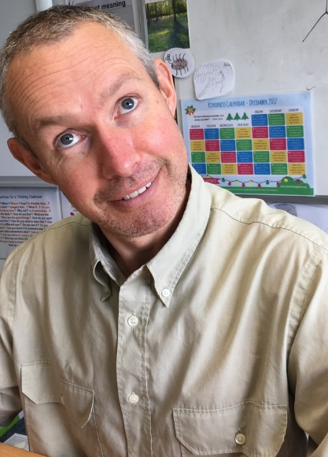
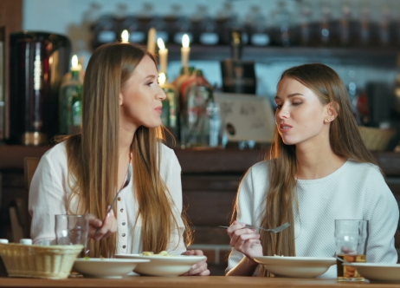

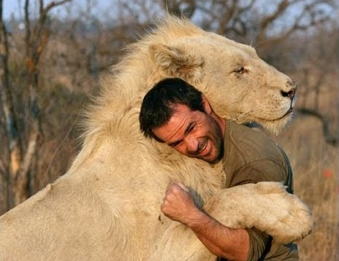
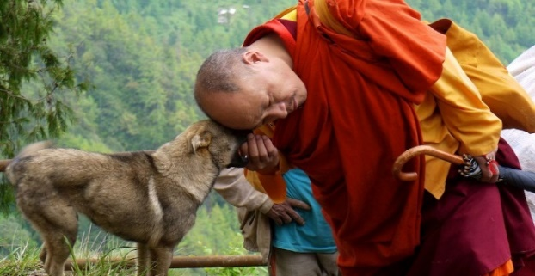
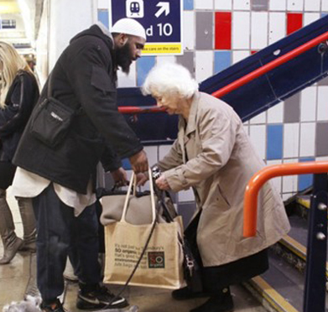
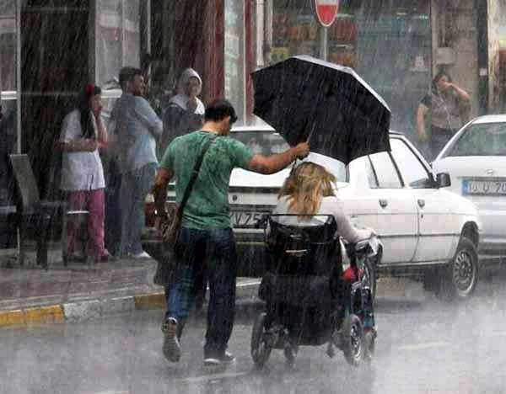
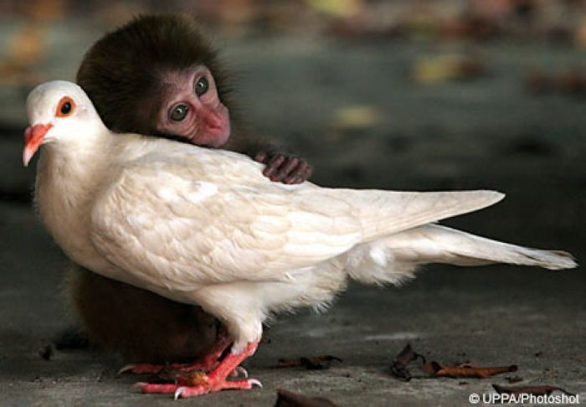
ODD ONE OUT! All other images show acts of kindness
METTA – kindness, without expecting anything back!
What do most images have in common?
Which image is the odd one out?

Slide 4

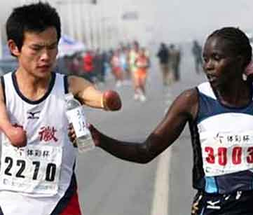

METTA:
kindness before someone is suffering
KARUNA:
compassion for suffering when someone needs help
Provide 2 examples of either metta or karuna
Bright Spark

Slide 5
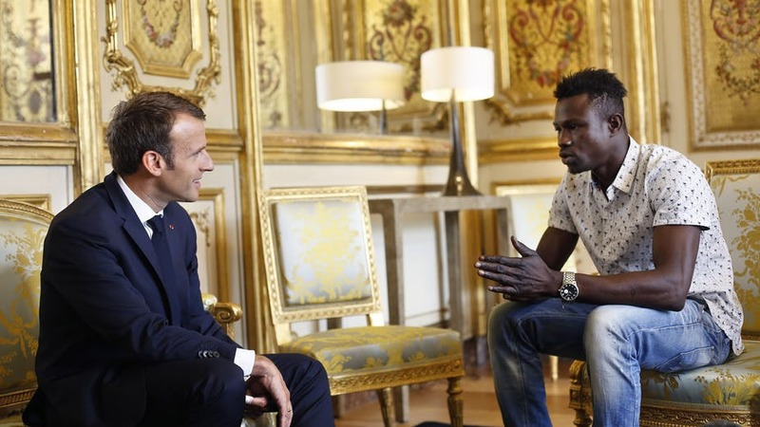
Karuna (compassion for suffering) in France
Does this clip show karuna or metta?
A man saves child falling from balcony and risks his own life, he is now being called Paris’ Spiderman! French president rewards Spiderman with French citizenship
PLAY
Notes:
https://www.youtube.com/watch?v=33n1ngFffXo – French spiderman

Slide 6

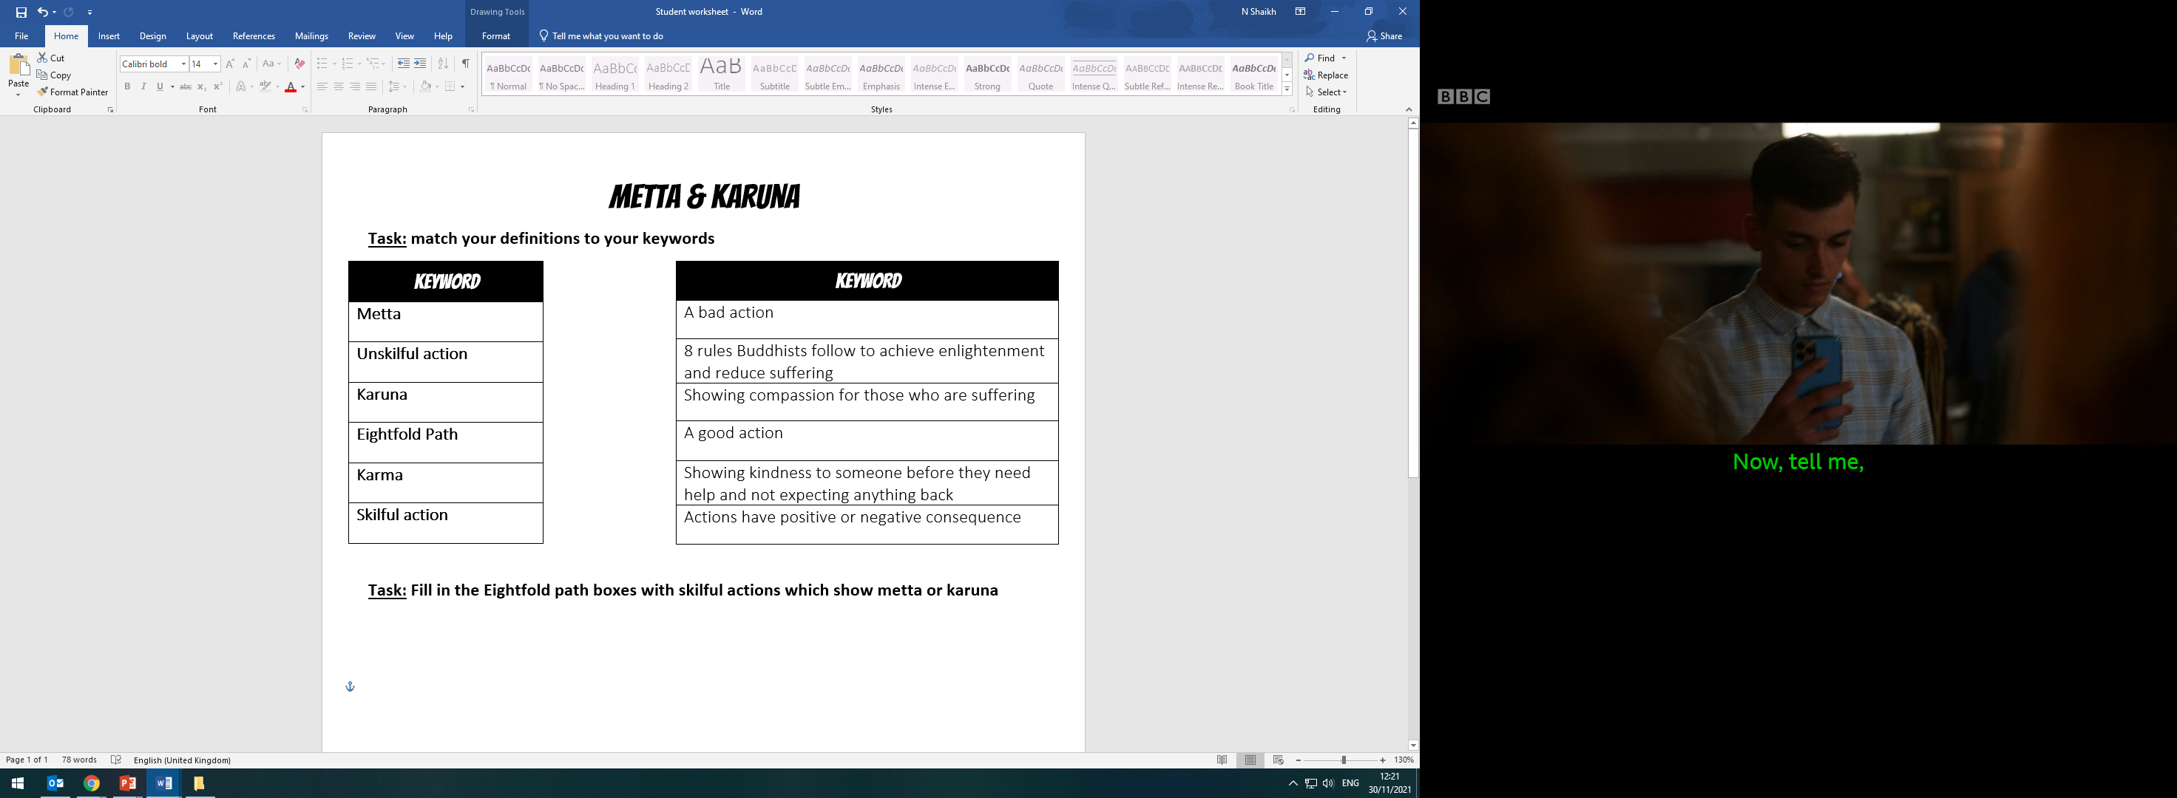

TASK 1: match your definitions to your keywords
How are Karuna and Metta linked to a Buddhist’s karma?
Bright Spark

Slide 7
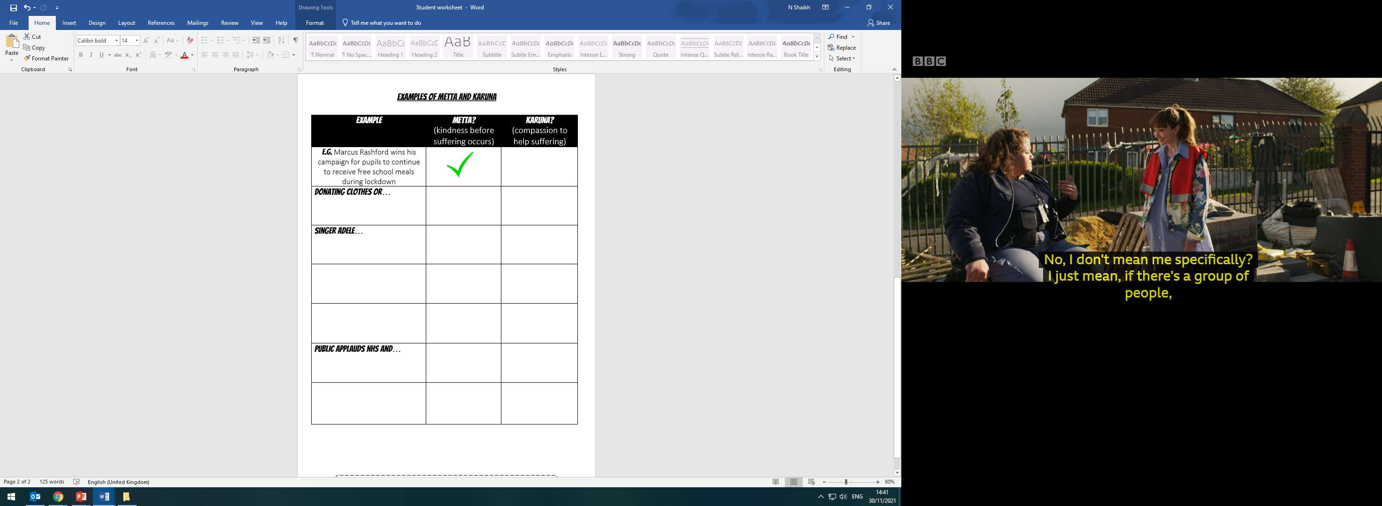
TASK 2:
Note down on your sheet different examples of metta and karuna
Decide at your desk whether the examples show METTA, KARUNA or BOTH
How does Karuna & Metta influence a Buddhist to behave?
Bright Spark

Slide 8
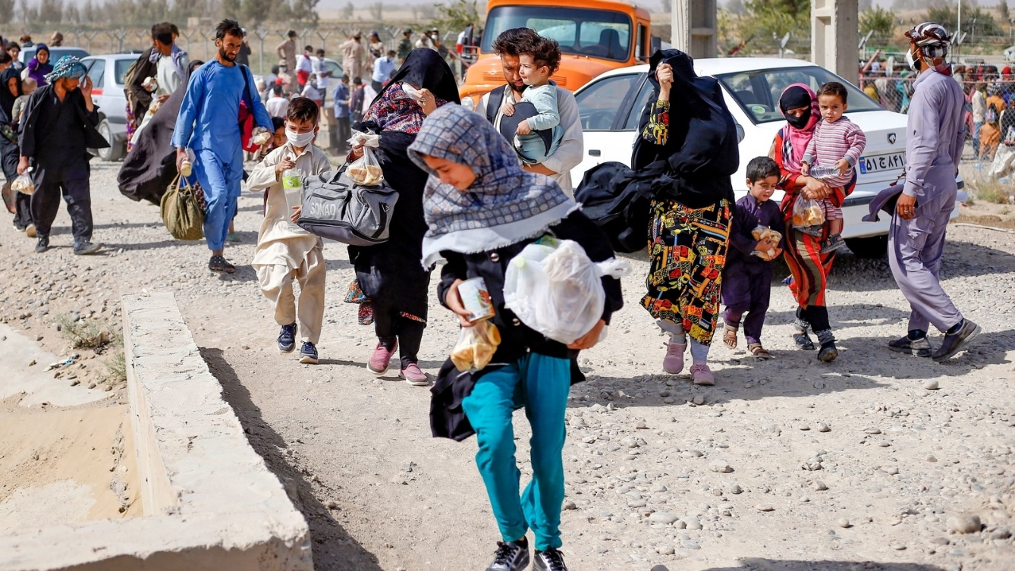
Donating clothes/food to refugees fleeing the Taliban in Afghanistan
KARUNA

Slide 9
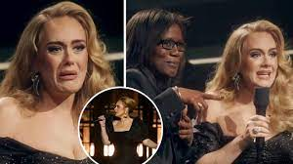
Singer Adele gifts former English teacher a free ticket to her concert and publicly thanks teacher
METTA

Slide 10
Man risks his own life by saving a falling toddler from balcony
KARUNA

Slide 11
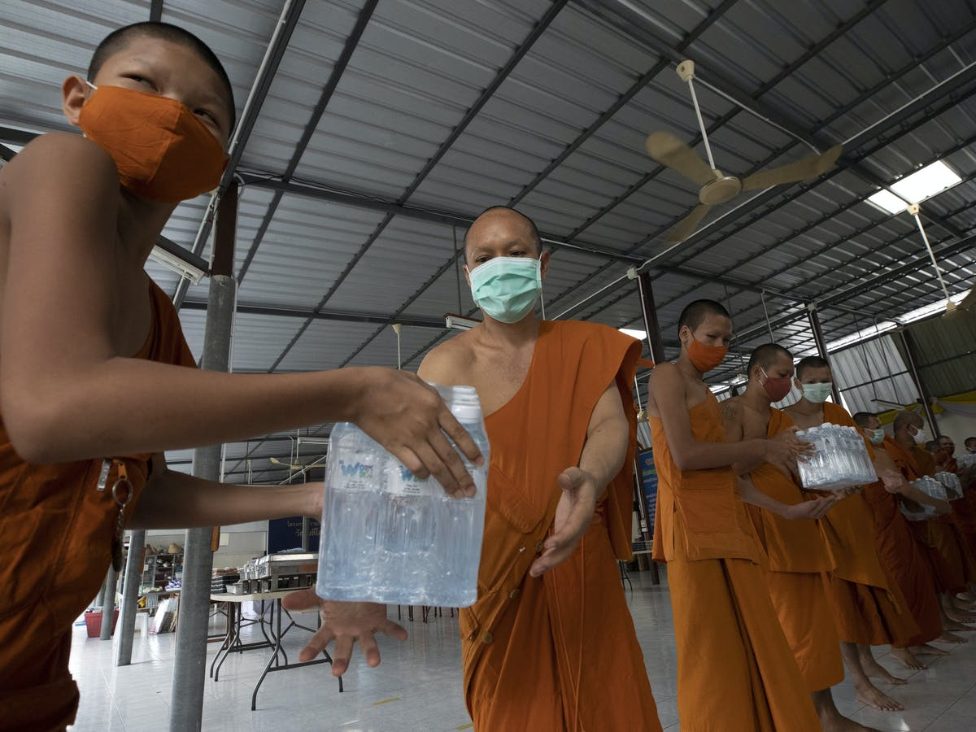
Buddhist Monks take on new jobs to help fight Covid-19
BOTH?!

Slide 12
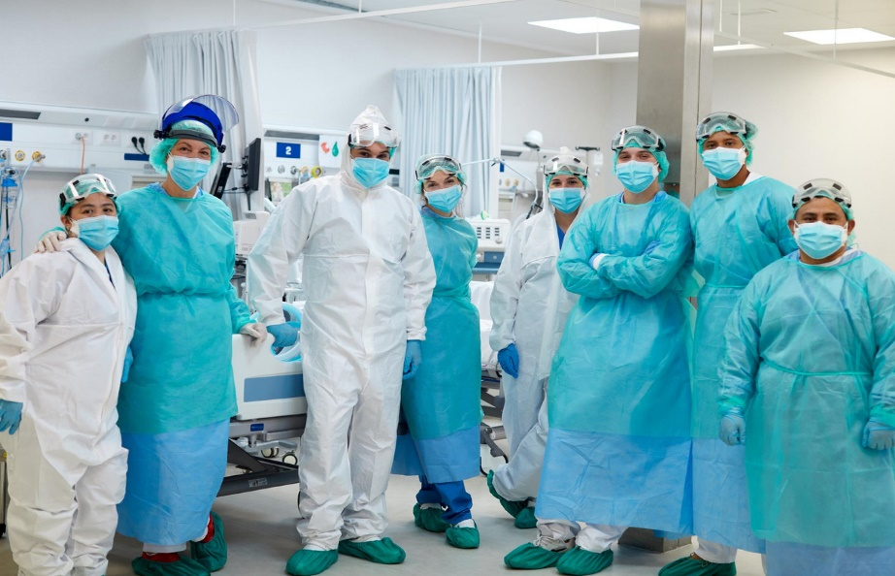
Public applauds NHS and frontline workers to thank them for their efforts during lockdown
METTA

Slide 13
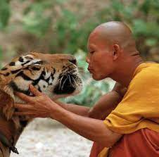
Buddhist monks open a tiger sanctuary to care for tigers left to die in wild
KARUNA

Slide 14
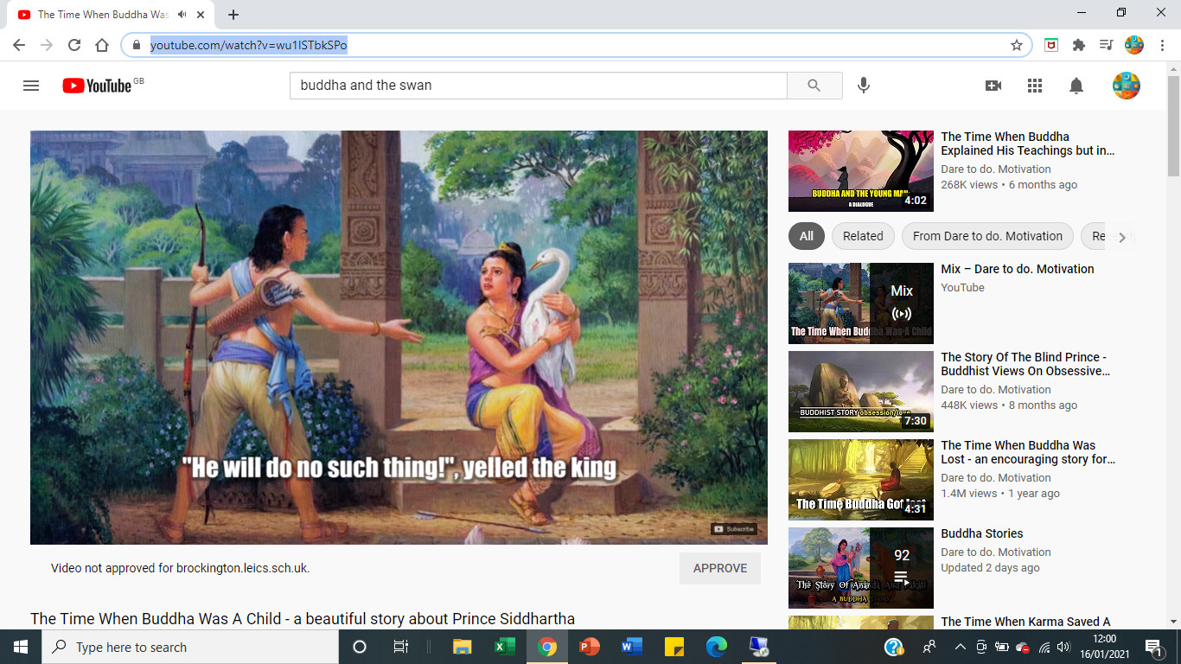
Sub-heading: Buddha and the Swan
What does the Prince do?
Prince helps injured swan by saving it from his cousin putting it to death
2) How does prince help?
Siddhartha looked after the swan till its broken wing was mended, and then released it back on the river.
3) Story teaches Buddhists to..?
This shows Buddhists importance of showing compassion to all living things, as the Buddha did.
https://www.youtube.com/watch?v=wu1ISTbkSPo
Notes:
https://www.youtube.com/watch?v=wu1ISTbkSPo
The Buddhist Stories of Siddhartha and the Swan and The Monkey King | Religions of the World – YouTube- KS3 version

Slide 15
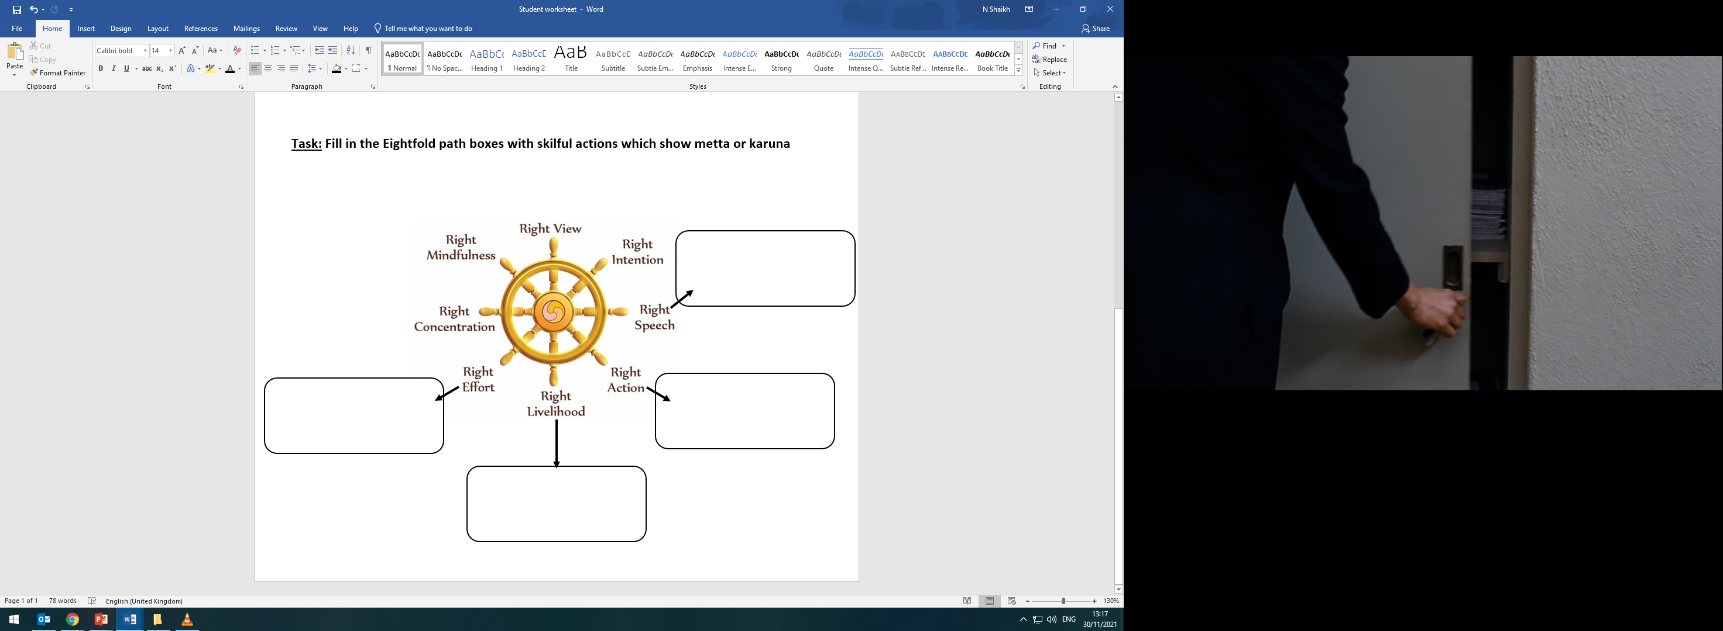
Task 3: Eightfold Path allows karuna and metta to be shown all the time
RIGHT LIVELIHOOD
RIGHT ACTION
RIGHT SPEECH
RIGHT EFFORT

Slide 16
GCSE Questions
1) Which of the following refers to a being who has achieved enlightenment and helps others to by staying in the cycle of samsara?
a) Arhat b) Visualisation c) Anicca d) Bodhisattva
2) Which of these meditation focuses on the 3 marks of existence?
a) Samatha b) Visualisation c) Anicca d) Vipassana
3) Which of these contains a Buddhist’s relics?
a) Mosque b) Church c) Stupa d) Synagogue
4) How many Kasinas are there in total for meditation?
a) 10 b) 9 c) 11 d) 8
5) Give two examples of skilful actions [2 marks]
6) Explain why a Buddhist must demonstrate compassion
[4 marks]

Slide 17
Explain why a Buddhist must demonstrate karuna [4 marks]
Point
Buddhists must demonstrate karuna because…
Explain
Some Buddhists can show compassion by…
Point
Explain
Buddhists can also show compassion by…
Enlightenment
Karma
Karuna
Buddha and the swan

Slide 18

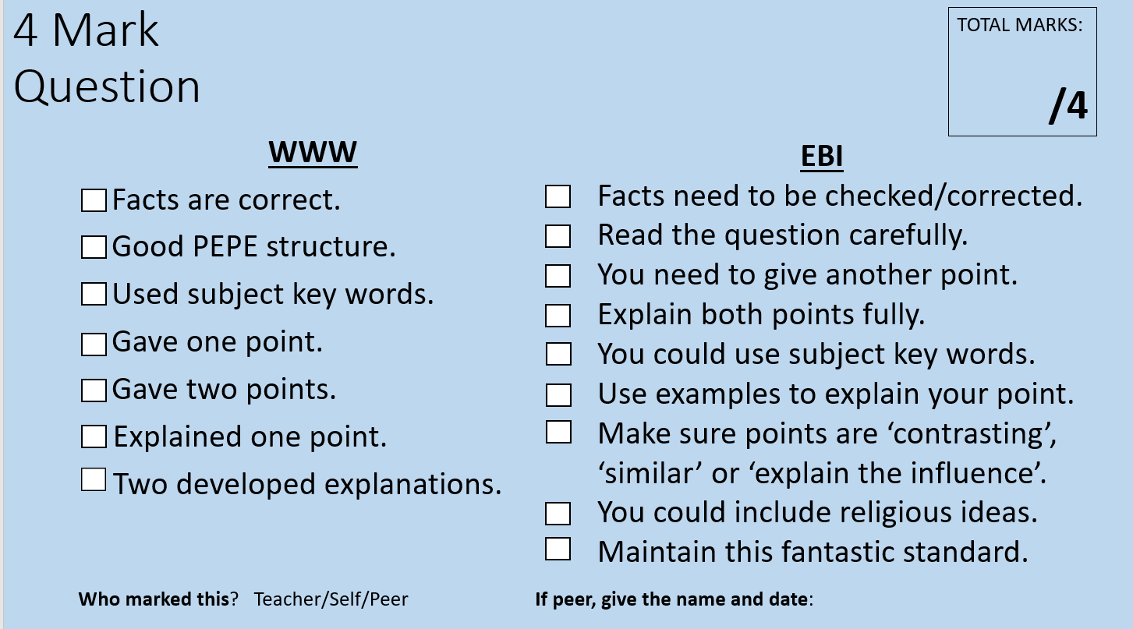
TASK: Peer-Assess using green pens & blue sheet
Marks: | Explanation of mark given
1 mark | Simple point and explanation
2 marks | Developed point and explanation or example
1 mark | Simple point and explanation
2 marks | Developed point and explanation or example

Slide 19


Buddhism Vs Christianity
Explain the similarities between teachings on metta/karuna and being a Good Samaritan
Bright Spark

Slide 20
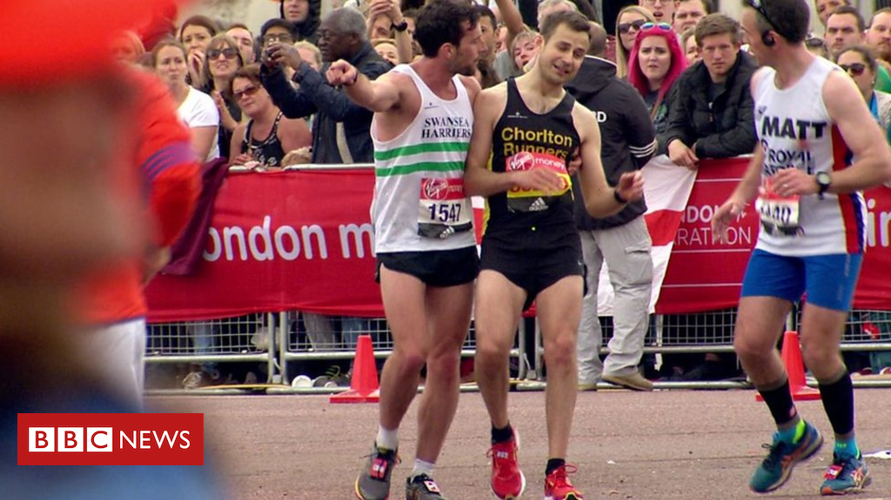

PROGRESS CHECK: Metta or Karuna?
London Marathon runner helps struggling rival to get to the finish line. He said, helping ‘guy in need’ was more important than winning
PLAY
Which part of the Eightfold Path does this action meet?
Bright Spark
Notes:
https://www.youtube.com/watch?v=R8biWiQTlhs – London Marathon

Slide 21
The BIG question: What is karuna & metta?
Grade 3-4: I CAN explain the meanings of compassion (karuna) and loving kindness (metta).
Grade 5-7: I CAN identify and provide examples of compassion and loving kindness from the Buddha’s life and the Eightfold Path.
Grade 8-9: I CAN apply knowledge learned and skills to GCSE exam-style question
Values: Compassion, Learning, Respect
If you understand these key words NOW, it will help you
all through your RS career
You will be able to apply today’s R.Teachings to Buddhist practices and link this to previous lessons on Karma and Enlightenment

