Slide 1
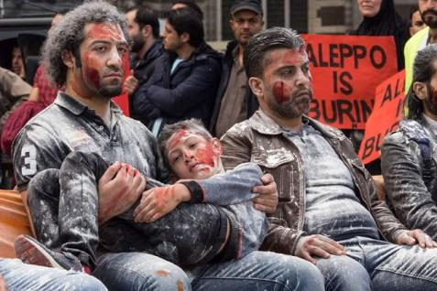
TITLE: Victims of War
Explain what “Be fruitful and multiply” means | Give 2 reasons marriages end | Explain what procreation & cohabitation means
Give 2 forms of contraception | Explain an advantage of using nuclear weapons | Give 2 reasons why people get married
Explain a disadvantage of using nuclear weapons | Explain what “your body is a temple of the holy spirit” means | What is the structure 5 mark GCSE Q’s?

Slide 2
LEARNING OBJECTIVE: Understand what can be done to help victims of war
I CAN discuss issues concerning victims of war (Grade 4/5)
I CAN explain the work of people who help victims of war (Grade 6/7)
I CAN support Christian views on why we should help victims of war (Grade 8/9)

Slide 3


KEYWORDS – copy definition into book
VICTIM OF WAR:
Suffering because of armed conflict

Slide 4

What is a victim of war?
Watch the clip together – sensitive content alert!
https://www.youtube.com/watch?v=mSiwsk1pVBI
https://www.youtube.com/watch?v=RBQ-IoHfimQ&feature=youtu.be&safe=true – Save the Children
TASK:
Write 2 key points about what a victim of war is
Watch this clip and make notes – how does it make you feel?
How could we help? Should we help? Explain your answers.
Bright Spark

Slide 5

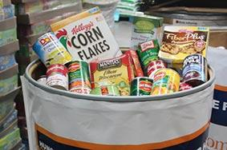
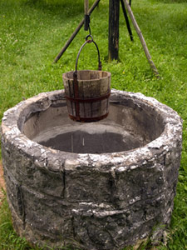

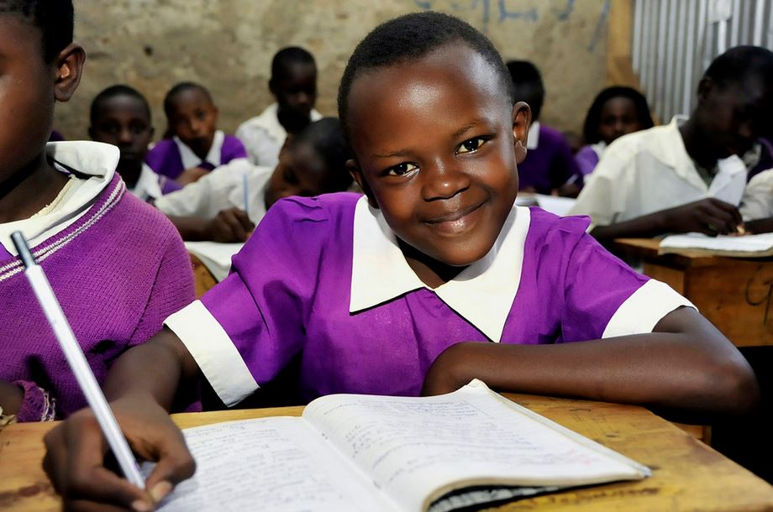
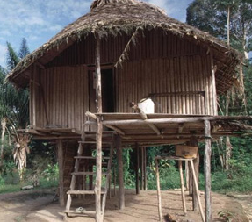

STARTER: List all the ways religious & non-religious people can help victims of war
Clothing
Food
Water wells
Medical aid
Education
Housing
Money

Slide 6
KEYWORDS – copy definition into book
Short-term aid:
Long-term aid:
Immediate relief in emergencies
Improves quality of life overtime

Slide 7
SHORT TERM Vs. LONG TERM AID
Short-term
Short-term
Long-term
Short-term
Long-term
Long-term
BOTH!

Slide 8


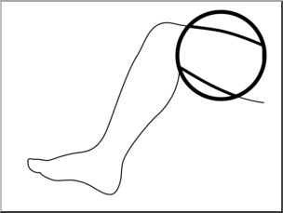
Pictionary
“love thy neighbour”

Slide 9
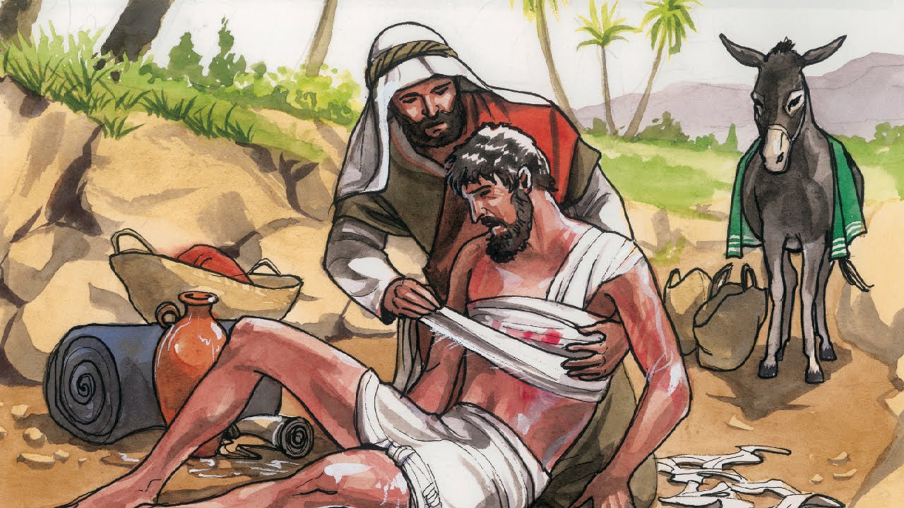
How does this parable influence Christians to help victims of war?
https://www.youtube.com/watch?v=slyevQ1LW7A - agape
Notes:
https://www.youtube.com/watch?v=osfQg4yKtq8 – Parable of the good Samaritan

Slide 10

GOLDEN RULE
“treat others how you want to be treated”

Slide 11
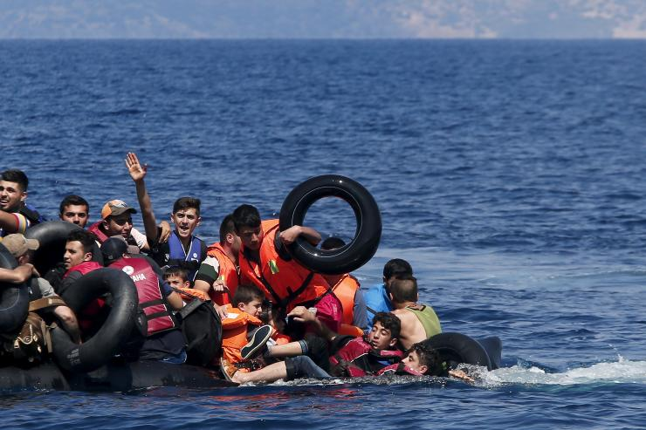
What if it were me?
As a result of wars in other countries, some people have to flee and leave everything they have.
These people are called refugees.
Watch the following clip and think about the different ways that the organisations that you have learnt about could help out in times of need.
What can we do?
https://www.youtube.com/watch?v=o_P9huLYmS0

Slide 12
https://www.youtube.com/watch?v=F0I-hWVVjZE
Notes:
https://www.youtube.com/watch?v=F0I-hWVVjZE – Who are Christian Aid?

Slide 13
Explain 2 religious beliefs about helping victims of war [5 marks]
Marker: Miss Shaikh
W.W.W:
(what went well)
E.B.I:
(Even better if)
Mark:

