Slide 1

Augustine on Human Nature
The BIG question: What does it mean to be human?

Slide 2
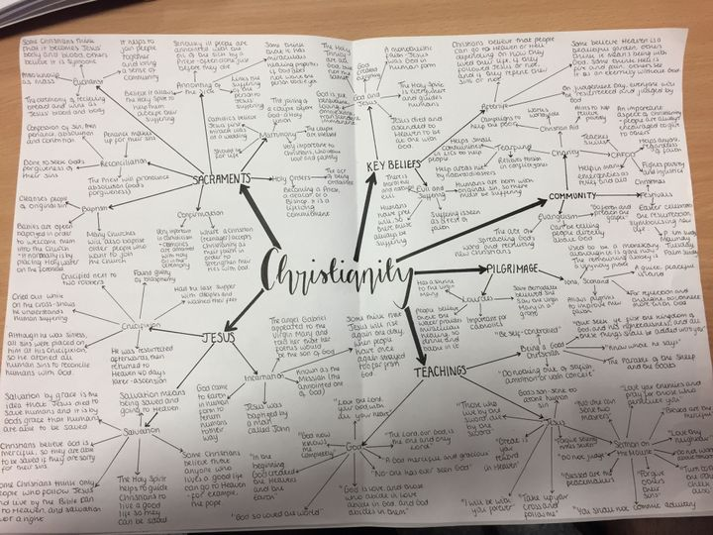
Christian beliefs
Create a mindmap with all your current knowledge of Christianity
Add notes about Augustine of Hippo

Slide 3
Brief background
• His mother Monica
• Manicheism
• Pelagius
• Augustine’s own experience of the power of human sexuality and the impact on human nature. Augustine’s interpretation of Genesis 2–3. The state of perfection before the Fall and Adam and Eve’s relationship as friends:
• The state of perfection in Eden and the sexual relationship as a rational act in response to the command of Gen. 1 ‘Go forth and multiply’.
• Adam and Eve’s friendship not based on sex.
• Unity of body and soul. Lust and selfish desires after the Fall:
• The division of the unity of the body and the soul and the divided will.
• The importance of concupiscence
• The sexualisation of humanity
• Augustine view on the role of women in the Fall

Slide 4
Key words:
Will: the part of the human nature that makes free choices
Sin: disobeying the will and commands of God
Grace: God's free and undeserved love for humanity Jesus on cross
The Fall: the Bible event with Adam and Eve disobeying God , fruit tree garden of Eden
Neoplatonism: thinking around the ideas of Plato
Redeemed: saved from sin by the sacrifice of Christ
Concordia: human friendship
Caritas: generous love like agape
Concupiscence uncontrollable desire for physical pleasures and material things
Ecclesia: heavenly society opposite to earthly society
Summum bonum: the highest most supreme good Bonham

Slide 5

Introduction video

Slide 6
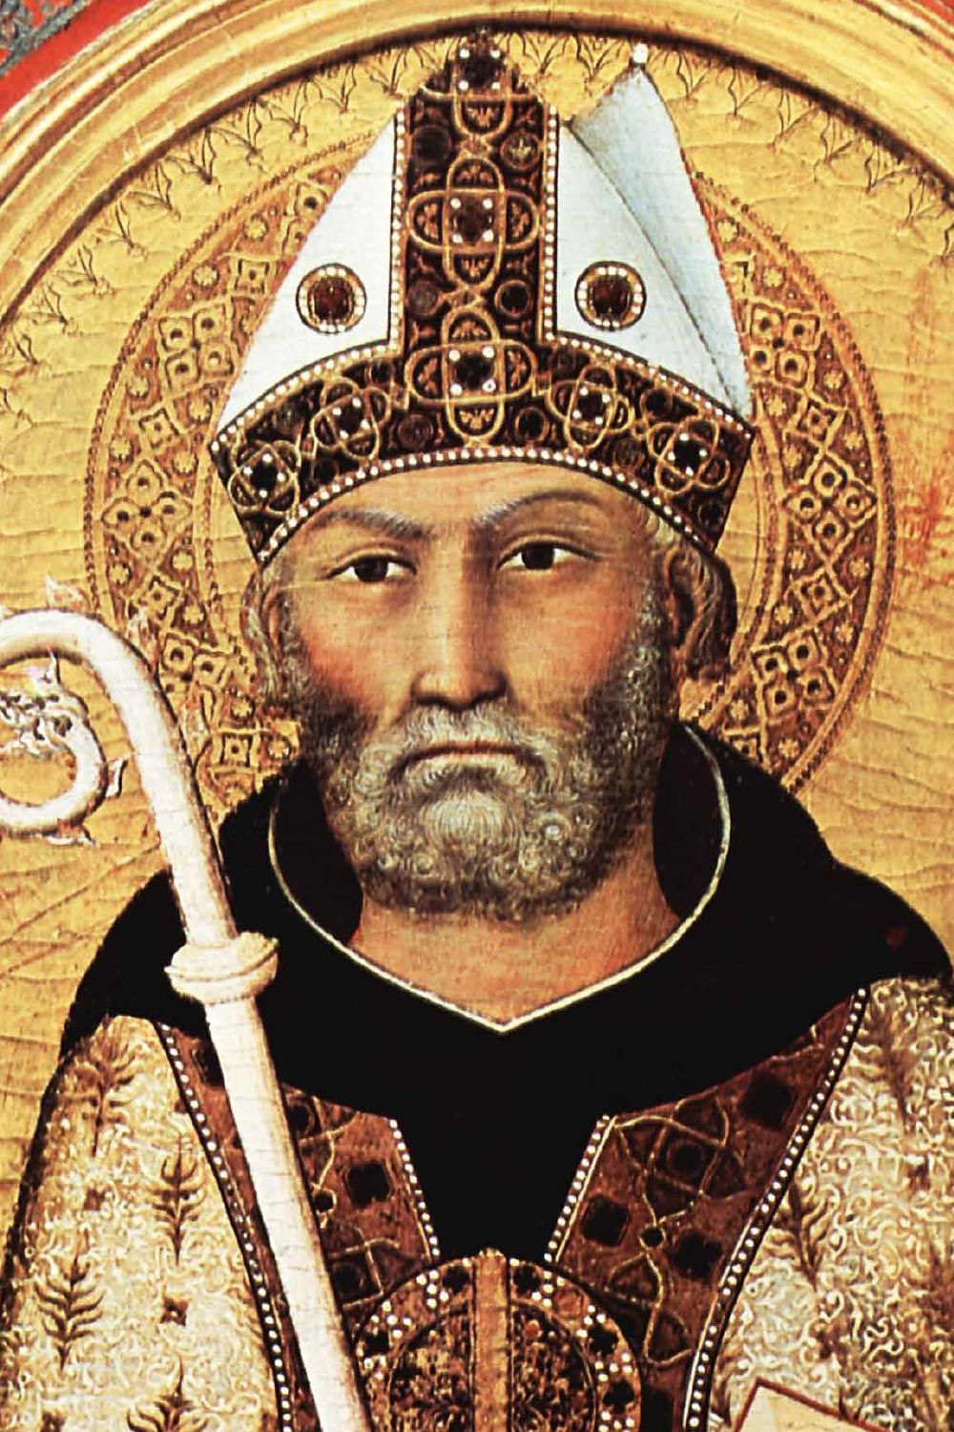
Questions:
What are the advantages of growing up in a multi-faith society?
How does this compare to your own upbring?

