Slide 1
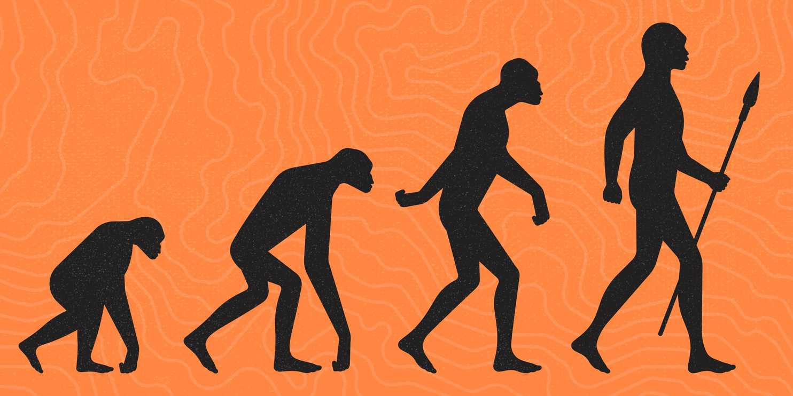
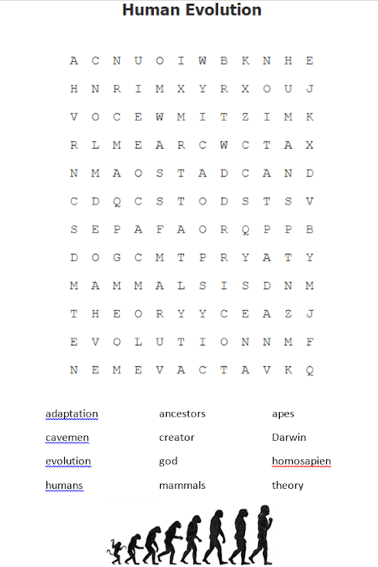

Wednesday, 27 April 2022
TITLE: Charles Darwin
STARTER:
Complete wordsearch
Complete Bright Spark
Stick wordsearch into book
Explain how you think the world began. Is there any proof for this?
Bright Spark

Slide 2
Wednesday, 27 April 2022
TITLE: Evolution
Define: Genesis | Why is it sometimes hard to forgive people?
What was the point of M.L.K’s “I have a dream” speech? | What does Big Bang Theory tell people?
How many days did God create the world in (Christianity)? | Unscramble the word below vElntuioo
STARTER:
Answer any 5 questions from the grid..
Can you GIVE ME 5?!
Explain how you think the world began. Is there any proof for this?
STRETCH

Slide 3
Learning Objective: to understand Charles Darwin’s Evolution theory
I CAN explain my opinion on how I think humans were created
I CAN identify and sequence the different species involved in the evolution process
I CAN create a facebook profile for Charles Darwin, outlining his journey towards the evolution theory

Slide 4

Evolution:
changing to adapt to
your environment
What do you think humans have evolved from and why?
STRETCH
https://www.youtube.com/watch?v=-NFfSLlCawE

Slide 5
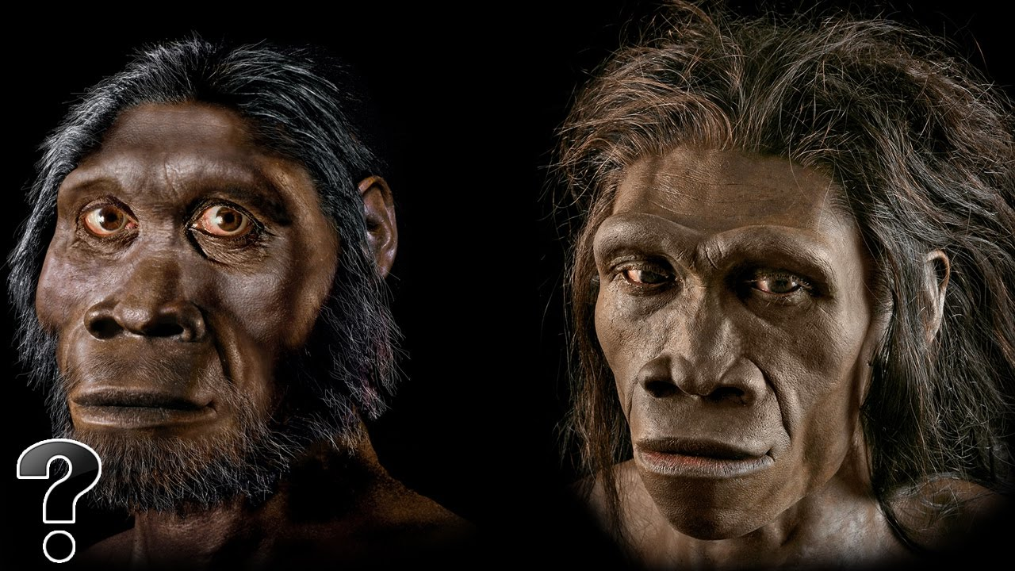
Walk through Evolution…
Split page into 7 boxes
Walk around the room through changes in evolution
Write/draw in each box what you see and changes in evolution
1
2
3
4
5
6
7
Can you put all the different species in order of evolution?
STRETCH

Slide 6
YELLOWS: draw or write 2 bullet points for each event card
BLUES: 2 detailed bullet points for each information card
PURPLES: 2 detailed bullet points for each card + Bright Spark
ORIGIN OF SPECIES
WHO WAS DARWIN?
ANGER AT CHARLES
CHARLES DARWIN
THE BEAGLE
HUMAN EVOLUTION
What would a Christian response be to the evolution theory?
GALAPAGOS ISLANDS
STRETCH
Notes:
https://www.youtube.com/watch?v=urSNtaQKOAk&safe=true

Slide 7
WHAT WAS DARWIN’s DREAM JOB?
4
1
WHAT IS THE GALAPAGOS?
WHAT IS THE EVOLUTION THEORY?
5
2
WHY WERE PEOPLE ANGRY AT DARWIN?
3
6
WHAT WAS THE SHIP CALLED WHICH DARWIN BOARDED?
WHAT WAS THE NAME OF THE BOOK DARWIN WROTE?

Slide 8
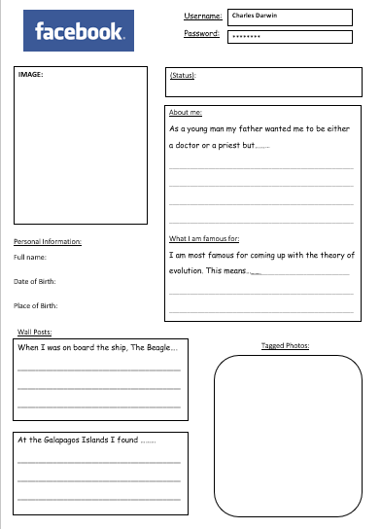
Create a FACEBOOK profile
for DARWIN
BLUES: Use 3 keywords in profile
PURPLES: Use 4 keywords in profile
Use spider-diagram information to complete Facebook profile for DARWIN
What 3 questions would you like to ask DARWIN about his life?

