Slide 1

What are Augustine’s teachings on Human Nature?
Give five pieces of information/words about:
Plato
Paley
Augustine

Slide 2

Course Outline
Philosophy of Religion
Ethics
Developments in Christian Thought
Augustine on Human Nature
Death & Afterlife
The person of Jesus Christ
Christian Moral Principles
Knowledge of God
Christian Moral Action
Ancient Greek Influences
Natural Law Theory
Situation Ethics
Kantian Ethics
Utilitarianism
Euthanasia
Business Ethics
Mind, Body, Soul
Existence of God
Ontological Argument
Theodicy
Religious Experience

Slide 3
Key Words
Human nature: the general psychological characteristics, feelings, and behavioural traits of humankind, regarded as shared by all humans.
TASK:
Many philosophers have made claims about what they believe to be the essential qualities of human nature. Out of the list here which ones do you believe are distinctly human and why?
Love Desire Generosity
Suffering Hatred Justice
Equality Anger Evil
Forgiveness Greed Kinship
Faith Compassion Self-interest

Slide 4
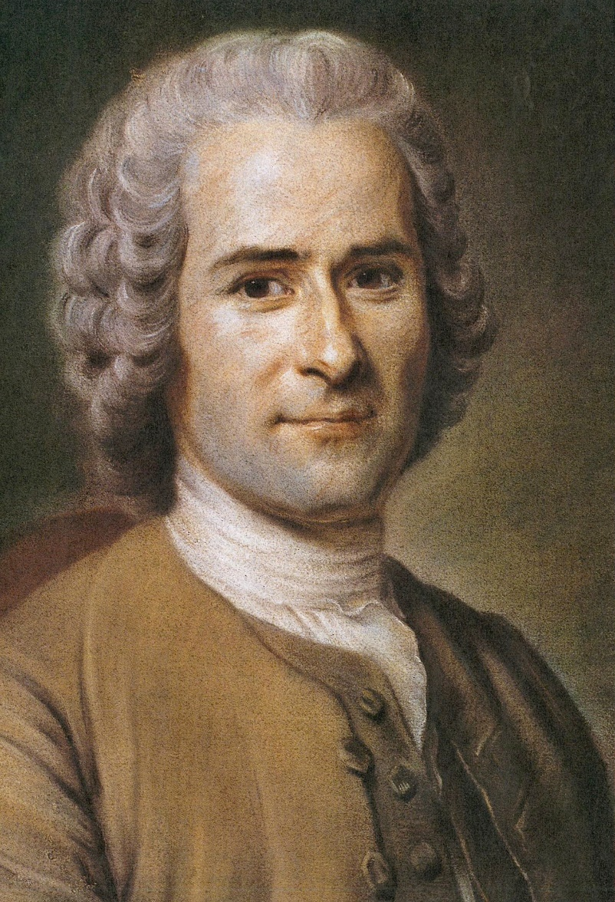
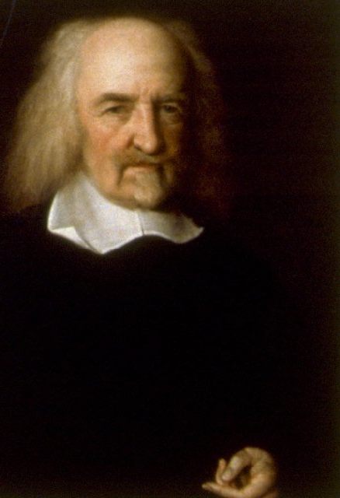
Traditionally philosophers tend to prefer two alternative explanations of what they understand human nature to be. These are best illustrated by the competing ideas of Thomas Hobbes and Jean-Jacque Rousseau:
Rousseau - 28 June 1712 - Geneva
Hobbes - April 1588 - English
Rousseau argued In their natural state, humans are essentially generous creatures and only act otherwise when situation and circumstance cause them to. He remarked, “Man is born free, and everywhere he is in chains.”
For Rousseau the purpose of our society should be to remove barriers that had resulted in our loss of freedom and try and regain our natural state as helpful, just and social beings.
In contrast, Hobbes argued that in their natural state humans are not co-operative but selfish and brutish (animal-like). He said, “The life of man, solitary, poor, brutish, and short.”
Humans are, however, different from animals in that they recognise if they co-operate with each other life can become more tolerable. This, however, often has to be backed with the threat of force (the police, the army, the courts) to make sure we don’t go back to our selfish ways.

Slide 5

Are humans essentially brutish and violent?
Watch 1:09 – 6:35
1) What are the views of Hobbes and Rousseau?
2) What does anthropology suggest about human nature?
3) How might evolutionary science explain war and violent behaviour?
4) Is human nature more the result of nurture or nature?

Slide 6
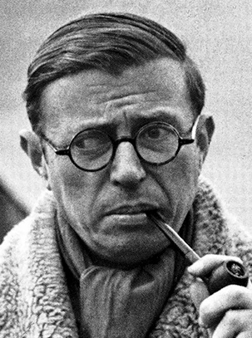
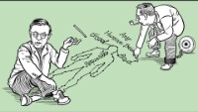
More recently some philosophers have come to question the idea of human nature altogether, suggesting that humans are too changeable and flexible to have just one nature
Sartre argued that we do not come into this world already determined by a ‘nature’, culture or anything else. ‘Existence precedes essence’, in other words, first we exist, and then we determine our own nature or essence by the choices we make.
We are completely free as individuals to decide who we are and what we want to become
This can be frightening, but also liberating.

Slide 7

Brain Dump
Write down everything you remember about today’s lesson:
Rousseau
Hobbes
Sartre
Then afterwards check your notes and the powerpoint. What did you remember? What did you forget?

Slide 8
What we will look at this week…
Augustine’s interpretation of Genesis 2–3. The state of perfection before the Fall and Adam and Eve’s relationship as friends:
• The state of perfection in Eden and the sexual relationship as a rational act in response to the command of Gen. 1 ‘Go forth and multiply’.
• Adam and Eve’s friendship not based on sex.
• Unity of body and soul. Lust and selfish desires after the Fall:
• The division of the unity of the body and the soul and the divided will.
• The importance of concupiscence.
• The sexualisation of humanity
• Augustine view on the role of women in the Fall

Slide 9
Timeline
354 Is born at Thagaste, modern Algeria.
387 Returns to Milan, is baptised by Ambrose
392 Debates in Hippo with Fortunatus the Manichee
c. 400 Writes his Confessions
c. 403–412 The Donatist controversy
412–421 Pelagian controversy
413–426 Writes The City of God, On the Trinity, and The Enchiridion

Slide 10
Are humans in control of their lives?
Key terms: (make a note in your own words)
Esoteric – teachings which are only intended to be understood by only a small number of people with specialized knowledge.
Manicheism – A form of esoteric Christianity which believed that suffering and evil in the world are not caused by God but by a lower power e.g. Satan. Humans have two souls, the higher soul desires God and the lower soul desires evil.
Platonism – usually referred to neoplatonism is the term scholars used to refer to the followers of Plato in the 3rd century AD, notably Plotinus (205-270ad). they believed that the soul can ascend to merge with the one go with God where encounters truth wisdom and happiness. Open

Slide 11

Let’s remind ourself of the fall

Slide 12
Visualiser
Read sheets together
Annotate – label AO1, AO2, highlight key terms
Choose an essay title and complete plan
To continue tomorrow before Kahoots

Slide 13
Augustine – influences on his life
Pelagius was a Christian monk who massively impacted Augustine’s theology. He did not believe that original sin caused universal guilt which only God could remove. The pelagians argued that humans have sufficient free will to overcome personal sin. Pelagius taught:
Even if Adam had not sinned he would have died
Adam’s sin harmed only himself not the human race
Children are born in the same state as Adam before his fall
The whole human race neither dies through Adam's sin or death nor rises again through the resurrection of Christ
Even before the coming of Christ there were men who lived without sinning

Slide 14
Augustine – influences on his life
Augustine opposed Pelagius, stating that human nature after the fall of Adam and Eve is entirely corrupt and that Adam's original sin and guilt is passed on from generation to generation.
Therefore because all humans are born in sin they are incapable of choosing to do good or to follow God, that is only possible because of God's grace.
But in refuting pelagius, Augustine took an increasingly hardline view that God's grace would only extend to a select few, the elect. Although he had officially rejected manicheism this aspect of his theology was strongly reminiscent of manichean teaching.

Slide 15
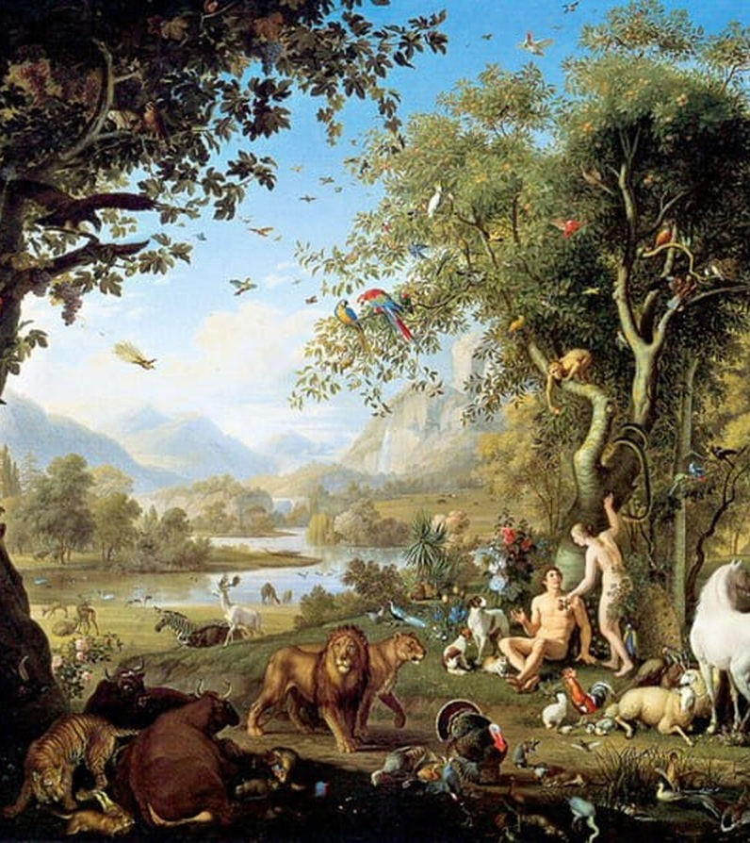
His views on humans before the fall
Augustine’s starting point is Genesis 1 to 3. Here we are given accounts of the creation of man and woman, their time in the garden of Eden paradise, their relationship with each other, the natural world and God.
Until the fall, humans enjoyed a time of harmony. Harmony is expressed in the complete obedience of Adam and Eve to God and in their duties to other living creatures.
It is also, according to Augustine, a time when the human body, will and reason are in complete cooperation with each other.

Slide 16
Augustine on - The will
The will is God-given, created along with humans ex nihilo, from nothing, and can choose to do good or evil, to believe in God or to reject him.
The will determines the kind of person we are. Above all, the will is synonymous with love, a kind of force or weight pulling us in various directions. Therefore, the will is driven by cupiditas, meaning self-love and caritas, meaning generous love.
These are both necessary elements of will, for in order for a person to love his neighbour he must also love himself, this in turn leads to the love of God.

Slide 17
Augustine - Sex and friendship
Augustine wrote extensively on friendship. And his groundbreaking commentary on genesis, Augustine argued that in paradise Adam and Eve were not only married but married his friends where they equally and mutually participated in the friendliness of God.
Augustine argued that as God had commanded Adam and Eve to be fruitful and multiply and fill the earth, in genesis chapter one verse 28, then friendship between men and women also included reproduction as well as the pleasure of sex.
Nevertheless, sex is always secondary to friendship, friendship being the highest expression of human existence.

Slide 18
Human will after the fall
And the Lord God commanded the man, ‘you may freely eat for every tree of the garden but of the tree of the knowledge of good and evil you shall not eat, for in the day that you eat of it you shall die.’ genesis 3:16-17. Augustine discusses the fall from genesis 3 at length in his city of God.
The key problem which faced Augustine was what caused humans to reject their perfect relationship with the world and with God.
The answer is pride. Augustine interpreted Adam and eve's decision to eat from the forbidden tree of knowledge and Eden to be a sign of their desire to be like thought, knowing good and evil and having its powers. Pride means that they can never again enjoy their harmonious relationship with God and with each other because cupiditas has now been separated from Caritas.

Slide 19
Human will after the fall
Nevertheless, there still remained the question of how the idea of wanting to have God's knowledge and disobeying God's command could have entered the minds of Adam and Eve in the first place. Augustine's answer is based on the tradition that Satan was originally an Angel who threw pride fell from grace and tried to rule the earth.
In Eden he takes on the form of the serpent and out of envy he plants the idea of disobedience into eve's mind. Satan's idea of disobedience is not the cause of the fall but it provides the stimulus for the will to obey disobey God's commands. God may have foreseen that Adam and Eve would disobey him, but Augustine stresses that the act of rebellion is entirely the result of human free will.
As he says more than once ‘the evil will proceeds the evil act’. So Augustine argues, as obedience is the mother and guardian of all the other virtues, pride or disobedience is the cause of all other vices.
Importantly, if the evil will proceeds the evil act, then it's not the body which is corrupt but the will. Augustine resisted the manichean idea that the body was evil and corrupt but now that the well is weakened it is unable to Control Board leaders eyes and the natural desires of food and sex, especially sex, are no longer in harmony with the will but dominate it.

Slide 20
Questions to consider
Is pride necessarily bad?
Why do people do the things they don't want to do?
Why is obedience a virtue?

Slide 21

Augustine’s theodicy

Slide 22
Reading
Black ipads Friday p1
Kahoots on all topics!
Augustine’s teachings on human nature

Slide 23

Retrieval
Write down everything you remember about Augustine, including further back on Augustine’s Theodicy
Then check your notes. What have you remembered? What have you forgotten?

Slide 24

Retrieval kahoots
Ancient Philosophical Influences - Details - Kahoot!
Aristotle and Causation - Details - Kahoot!
Cosmological Arguments - Details - Kahoot!
Ontological Argument - Details - Kahoot!
The Teleological Argument - Details - Kahoot!
https://create.kahoot.it/share/ocr-religious-studies-a-level-year-1-philosophy/a7f1268c-7678-4bf3-96f1-4ff3038d14fe

