Slide 1


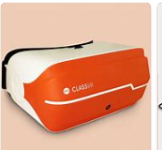
Life – the universe and everything in it!

Slide 2

The big question for this unit:
What are Aristotle’s ideas about what causes something to exist and the four parts of those causes?

Slide 3

Socrates, Plato and Aristotle – note taking

Slide 4
Key words:
Potentiality = something contains ingredients to become something else.
Actuality = object fulfils its potential and becomes something else.

Slide 5

What can you see in this picture?
This is not a trick question!
Aristotle (384-322 BCE) like other philosophers, was trying to understand the purpose of life!
He wanted to know exactly what the essence of an object was.
Aristotle started to explore this (differently to Plato) by looking at the world around him – the world of experiences and the senses.
So he looked at the table, rather than like Plato, looking beyond the table to the idea Form.

Slide 6
Aristotle concluded that there were FOUR CAUSES for the existence of an object:
1. The MATERIAL cause (what it is made of)- wood, nails
2. The EFFICIENT cause (the manufacturer/thing that made it) - The carpenter
3. The FORMAL cause (the design, its characteristics) - Its 4 legs and flat surface
4. The FINAL cause (its purpose) – to sit at and eat
TASK 1: Make notes on the 4 causes.
TASK 2: Take three contrasting objects and apply Aristotle’s four causes to each of them. Stretch: If Aristotle is right, can we apply this to everything n existence?

Slide 7
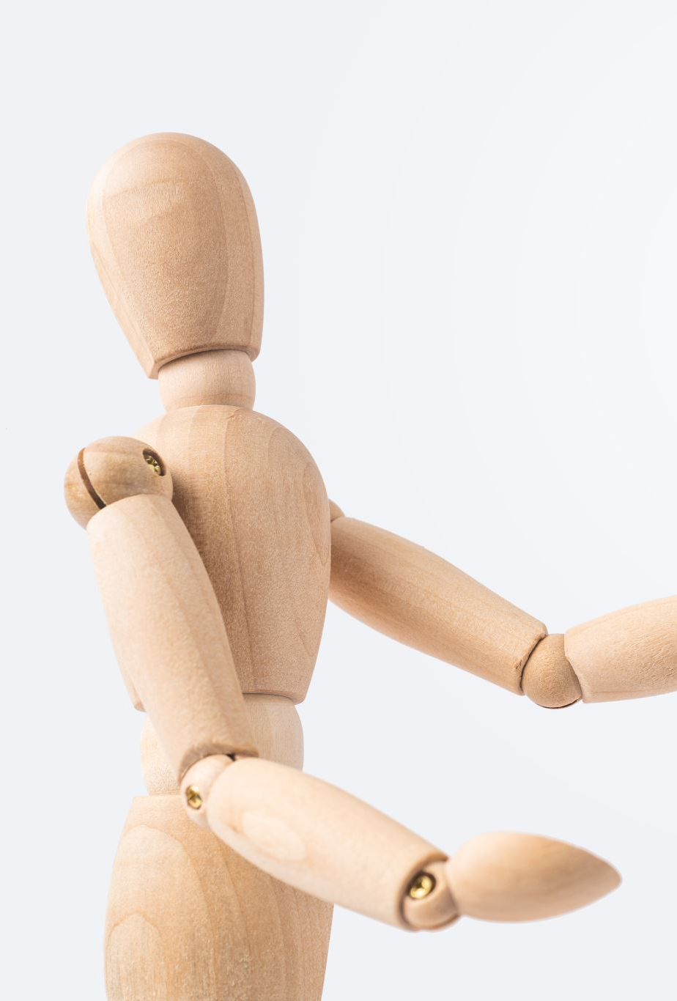
The FINAL cause = its purpose
This the most important to Aristotle
Why do you think this is?
TELOS = purpose. An argument concerned with the purpose or ultimate goal of something is called the teleological argument.

Slide 8
So?
So, if we understand the purpose of something is fully realised, then full perfection is reached.
If the object is doing what it is meant to do, then it has achieved goodness.
This, he said, applies to all things, even illnesses. An illness realises its purpose, and by Aristotle’s definition, has achieved perfection.

Slide 9


Debate
Aristotle has got it right. Do you agree?

