Slide 1

Title: Aristotle’s Prime mover
What are Aristotle’s 4 causes? MEFF
What is an empiricist? Are you one?

Slide 2

The big question for this unit:
What are Aristotle’s ideas about what causes something to exist and the four parts of those causes?

Slide 3
Aristotle’s Prime Mover
Like Plato, Aristotle believed that everything in life is constantly changing; people grow old, day turns to night, seasons pass, tides flow.
Aristotle reasoned that if everything has a cause and purpose, something must be causing this movement; he called that being the Prime Mover.
Consider the next clip – what is happening? What are the causes and effects? How does it begin?

Slide 4
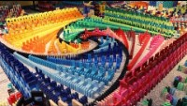
Dominos championship

Slide 5
Aristotle
“There must be a mover that moves them, without being moved, eternal and a substance, and actual”
Like with the domino, there must be substance that is separate, it must exist to start it must be different and eternal from the origin (like a finger pushing the first domino)
Aristotle was looking at the changing nature of life and concluded there must be an explanation for all the changes.
TASK: How is the domino example of an efficient cause, not a final cause?

Slide 6
So what does that mean for us?
Aristotle’s prime mover has to be outside of the universe and outside of time. If not, then you could ask ‘who started the prime mover’.
It can only exist in a spiritual way, otherwise it would be subject to change.
Aristotle’s God is therefore eternal and unchanging. Therefore, it must be good. Things which change are bad. Change means impermanence, which is bad. This God cannot have a relationship with anything outside of itself. It is unmoved. ‘It is the thought of thought’. It is transcendant and outside of time and space. It never intervenes.

Slide 7
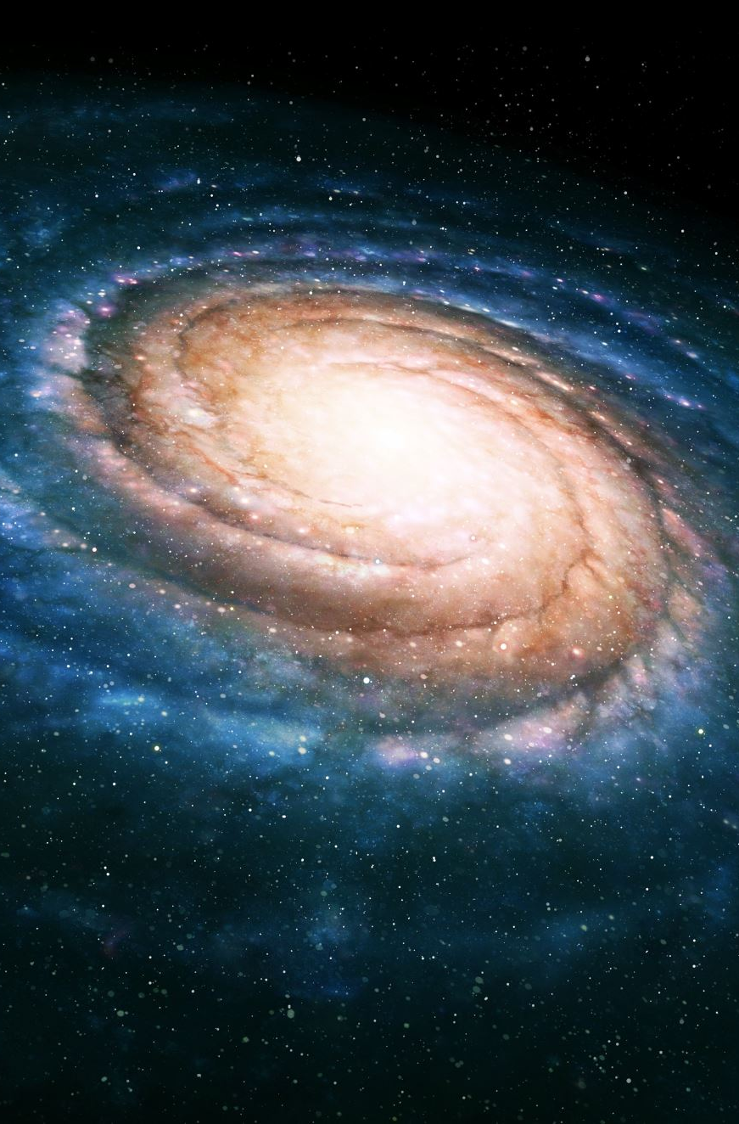

Weaknesses to the argument
How can the Prime Mover be omnipotent, yet not know about it?
What the Prime Mover caused too, if it is eternal thought, yet created a material universe?
Does there have to be a reason or final cause for the existence of the universe? Couldn’t we just be here by change?

Slide 8
Paired task
Helping hand – A3 sheet
What is Aristotle’s Prime Mover?
Create an infographic/poster explaining his theory, what it is, God as the Prime Mover and weaknesses to the argument.

Slide 9


Debate
“Aristotle’s Prime Mover is completely different to the Christian concept of God!”

