Slide 1
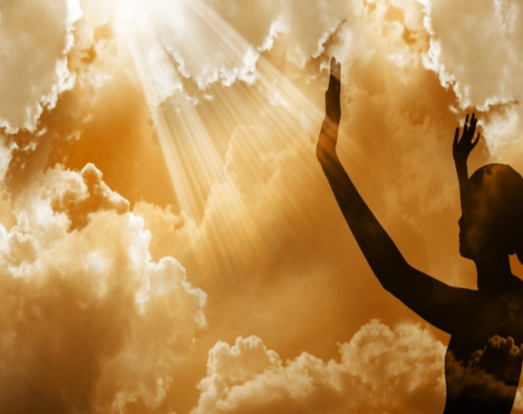
New topic: Religious experience
Do religious experiences prove God’s existence?

Slide 2
Homework due in
Please complete the following tasks before out next lesson:
1. Complete your ontological argument mindmap/essay/quiz/flashcards (continued from the lesson)
2. Watch one video. Create some evidence of your revision by sharing your notes next lesson.
The Cosmological argument - Aquinas & the Cosmological Arguments: Crash Course Philosophy #10 - YouTube
The Teleological argument - Intelligent Design: Crash Course Philosophy #11 - YouTube
The Ontological argument - Anselm & the Argument for God: Crash Course Philosophy #9 - YouTube

Slide 3
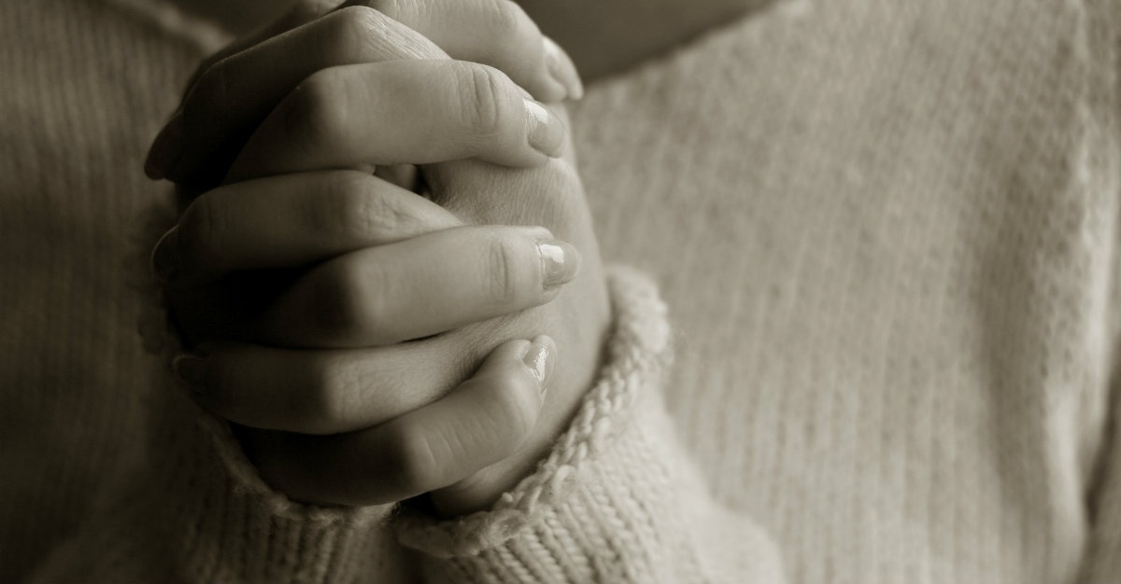

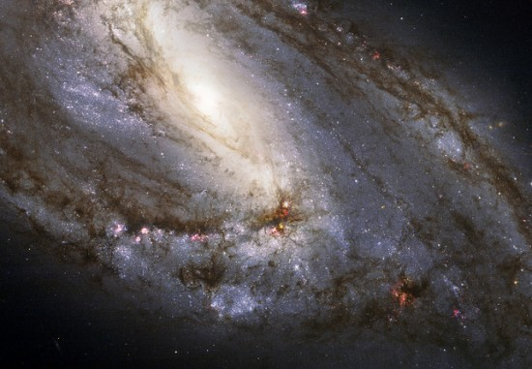
Discussion activity…
TASK- In what ways might a person claim to be able to experience God in their lives? Use the visual clues below to help your discussion.

Slide 4

Religious experiences – make notes
A religious experience is a non-empirical occurrence and may be perceived as supernatural.
It can be described as a ‘mental event’ which is undergone by an individual, and of which that person is aware.
Such an experience can be spontaneous, or it may be brought about as a result of intensive training and self-discipline.
Recipients of religious experiences usually say that what has happened to them has ‘drawn them into’ a deeper knowledge or awareness of God.
It is very important to remember that the experience itself is not a substitute for the Divine, but a vehicle that is used to bring people closer to the Divine.
The experience that each individual has is absolutely unique and cannot be shared with anyone.
Finally, genuine religious experiences see to be encouraging; they do not condemn the individual, but help them to live a better life, or help others, for example

Slide 5

Religious experiences
There are many different kinds of religious experiences, so bear in mind that any conclusions drawn about one type of experience may not apply to another.
For personages like St Paul, conversion experiences can be life-changing, as they can cause a person to modify their core beliefs about the meaning of life.
Some would say that even everyday acts of worship such as prayer are also a form of religious experience.
Some experience voices – they claim to hear God or Jesus speaking to them.
Others such as Julian of Norwich (who was a woman), Teresa of Avila, and Meister Eckhart claim to have experienced visions of God

Slide 6
Have you ever had, or known someone who has had a religious experience?
Think, pair, share

Slide 7

What are your thoughts?

Slide 8
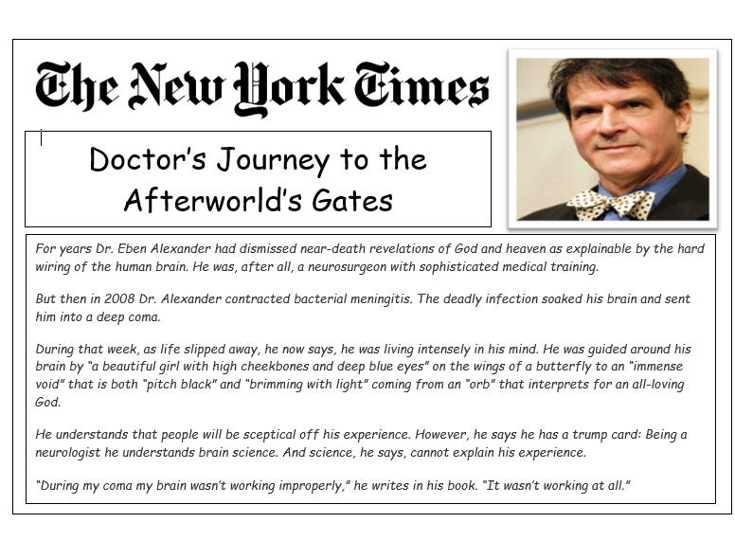

Slide 9
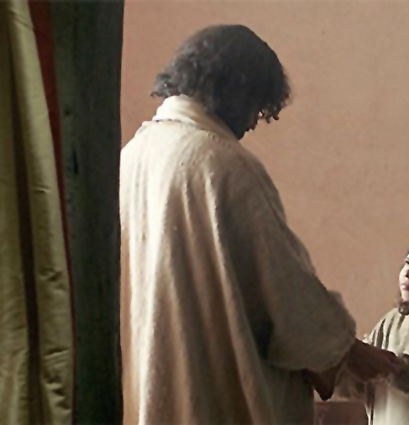
Religious Experience Case Study
In 2013 a couple by the name of Jeremy Osier and Lily Osier living in London. They had a young daughter aged 5, whose named was not disclosed. The couple themselves were not religious – they were atheists. As such, they never told their daughter anything about Jesus.
On July 13th of that year, in the evening, Jeremy and Lily had an argument. It ended up in a fight in which Jeremy shot Lily. Unable to cope with what he had just done, Jeremy then shot himself. The little girl witnessed the whole event.
The little girl was sent to a live with foster parents in another part of the city. The foster mother was a Christian and took the child to church. On the first day of Sunday School, the foster mother told the teacher that the girl had never heard of Jesus, and to have patience with her.
The teacher held up a picture of Jesus and said, "Does anyone know who this is?" The little girl said, "I do, that's the man who was holding me the night my parents died’.

Slide 10
‘The young girl’s experience proves the existence of God’
TASK:
Provide an argument in support
Provide an argument against
Which is the most convincing argument to the least convincing argument.
The young girl has no clear motive (reason) to lie about what happened to her. | She had not heard of Jesus before the incident. How else could she have known who He was without Jesus telling her? | She may have indirectly heard other people talking about Jesus or seen His picture before.
Jesus is recorded in the Bible as helping people. This might have been the way in which He helped her through that night. | There is no scientific theory that could adequately explain what happened to her. | There is no way to know whether the young girl is lying or not.

Slide 11
Title: What is the argument of religious experiences for the existence of God?
Retrieval Quiz:
Who is the philosopher associated with the concept of the "Forms" or "Ideas"?
Who is the philosopher associated with the concept of the "unmoved mover"?
According to Plato, what is the relationship between the mind and the body?
What is the teleological argument for the existence of God?
What is the cosmological argument for the existence of God?
What is the ontological argument for the existence of God?
What is the difference between Plato and Aristotle's concept of the soul?

Slide 12
Title: What is the argument of religious experiences for the existence of God? FEEDBACK
Plato
Aristotle
Plato believed that the mind and the body are separate entities, and that the mind is immortal and eternal, while the body is mortal and subject to change.
Aristotle believed that the mind and the body are intimately connected and that the mind is the form of the body.
The teleological argument is the idea that the design and order in the universe suggest the existence of an intelligent designer, often referred to as God.
The cosmological argument is the idea that the existence of the universe requires a cause, and that this cause must be an uncaused, necessary being, often referred to as God.
The ontological argument is the idea that the very concept of God, as a being that exists in the understanding, implies that God must exist in reality as well.
Plato believed that the soul is immortal and eternal, and that it exists independently of the body. Aristotle believed that the soul is the form of the body and that it is mortal and dies with the body.

Slide 13
What are the different types of religious experience?
TASK- Split your page into four boxes. In each space you need to:
Describe what that type of experience involves (in your own words)
Draw a brief supporting illustration
Prayer | Numinous
Conversion | Miracle
EXTENSION- Explain how one type of religious experience could lead to someone believing in God.
LO: To describe the different types of religious experience.

Slide 14
Do religious experiences prove God?
Think, pair, share
Write a paragraph explaining your opinion

Slide 15
Paired activities
As a class, read your A3 handout
1
Complete all 3 activities
2
Complete the stretch activities (4&5)
3
Complete the challenge (6)
4

Slide 16
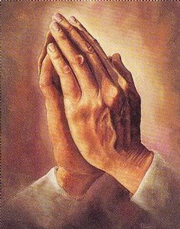
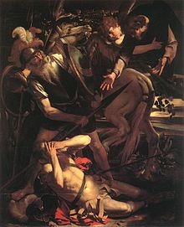
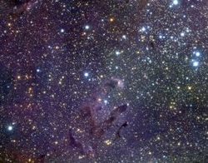
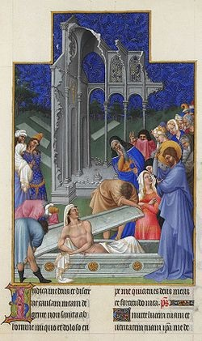
Title: Which religious experiences do you believe to be most convincing?
Prayer
Conversion
Numinous
Miracles

Slide 17
Class reading
Read together
Highlight key areas
Label AO1 for knowledge and AO2 for evaluation
Underline key terms
After Swinburn – 4th lesson
Summarise the Philosophical arguments
Provide the arguments for and against

Slide 18
Title: How can religious experiences prove God’s existence?
1. What are James’ four criteria for religious experiences?
2. James was a pragmatist. What does this mean?
3. What did Otto describe religious experiences as?

Slide 19

1. Ineffable – the experience is beyond language and cannot be put into words to accurately described. Noetic – some sort of knowledge or insight is gained. Transient – the experience is temporary. Passive – the experience happens to a person; the person doesn’t make the experience happen.
2. This is because James was a Pragmatist – a philosophical view on epistemology which states that if something is good for us, that is evidence of its truth.
3. Otto defined religious experiences as “numinous”; feelings of awe and wonder in the presence of an all-powerful being. Otto described the numinous experience as follows. It is an experience of something ‘Wholly other’ – completely different to anything human.

Slide 20


Class reading
Continue to read together - Freud
Highlight key areas
Label AO1 for knowledge and AO2 for evaluation
Underline key terms
Summarise the Philosophical arguments
Provide the arguments for and against

Slide 21

Essay writing
Use the planning sheet
Create your plan using notes
Write your essay
Peer assess using the marking grid

