Slide 1
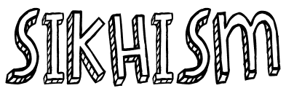
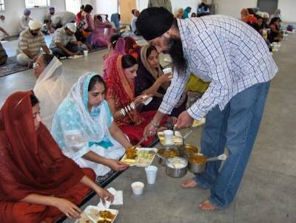
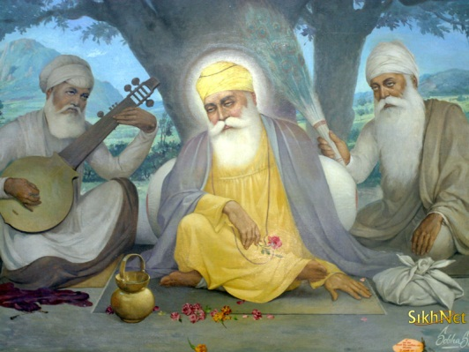
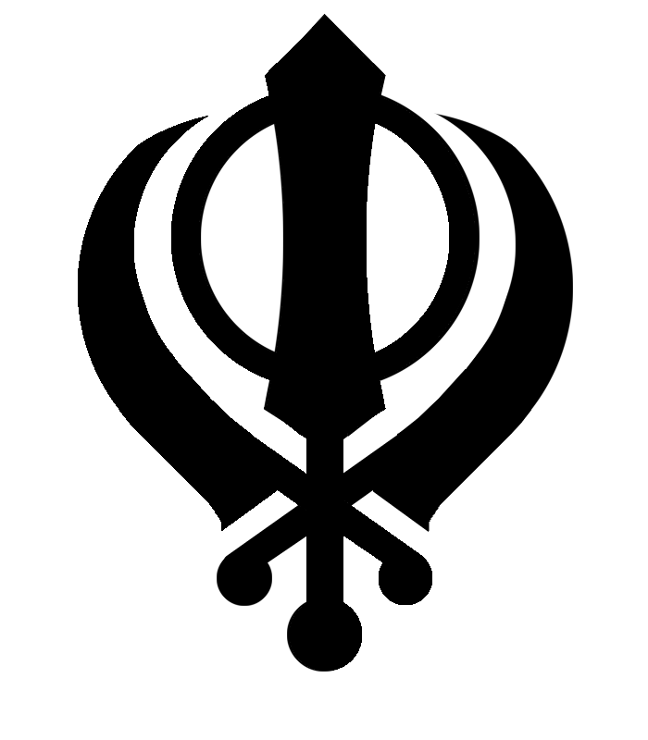
TITLE: How did Sikhism begin?
TASK: Where have your heard the word ‘guru’ before? What does it mean?

Slide 2
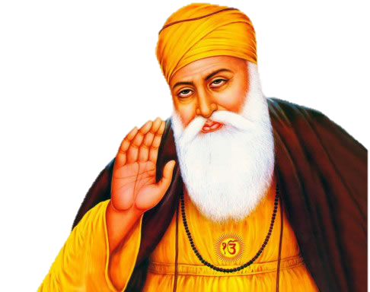
The BIG question: How did Sikhism begin?
Keywords:
Guru Nanak
Sikhism
“No Hindu, no Muslim”
Begin with Bronze: Identify who Guru Nanak is
Stretch with Silver: Describe how Sikhism began
Go for Gold: Investigate Guru Nanak’s teachings and how they effect a Sikh’s life.

Slide 3
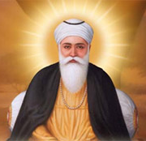
Who was Guru Nanak?
Sikhism was founded by a wise man called Guru Nanak. Guru Nanak is considered the first Sikh Guru.
Sikhism is still based on his teachings and those of the nine Sikh Gurus who followed him.

Slide 4
Who was Guru Nanak?
In Sikhism, there are many festivals known as Gurpurabs. These are holy days honouring the lives of the ten Gurus.
One of the most important is Guru Nanak Gurpurab, celebrating the birthday of the founder of Sikhism, Guru Nanak. After the death of Guru Nanak, beliefs were passed down through a series of ten Gurus for some 200 years.
Life in a Sikh community – KS3 Religious Studies – BBC Bitesize - BBC Bitesize

Slide 5
How is Guru Nanak Gurpurab celebrated?
To celebrate Guru Nanak Gurpurab, the Sikh community gathers together to take part in a street procession called a nagar kirtan. The Guru Granth Sahib (the Sikh holy book) is carried through the streets on a specially decorated float, Sikhs join together to sing, dance and play musical instruments.
Sikh worship and festivals are followed by the langar. This is a free, vegetarian meal which takes place in the Gurdwara, the Sikh holy building. This meal is offered to everyone, regardless of their faith and is cooked and served by both men and women, with everyone sitting together on the floor to eat. The langar symbolises equality, which was one of the most important teachings of Guru Nanak.

Slide 6
Research – information sheet
Read together and write answers out to the following questions:
Who founded Sikhism?
When is his birthday celebrated?
Where and when was he born?
What is the famous story about, from when he was 11?
How else did Nanak show his radical side?
What are some of his famous teachings?
STRETCH: Use your ipad to research what the caste system is. What were Nanak’s views on equality. Give as many facts/details as you can find.

Slide 7
Kahoot
https://play.kahoot.it/#/?quizId=0e084a0a-2038-47b9-b805-3d246b7d2156

