Slide 1

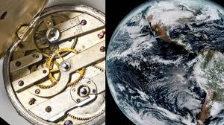
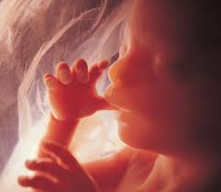

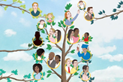
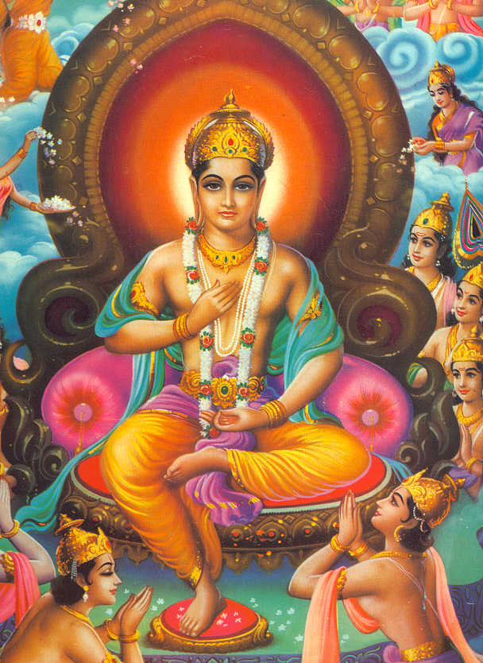
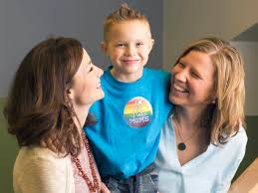
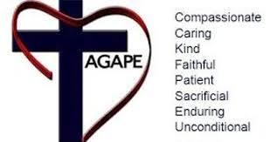
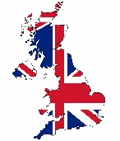

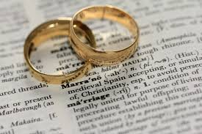


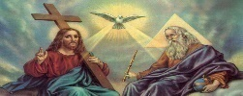
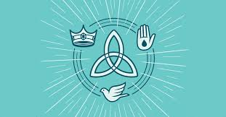
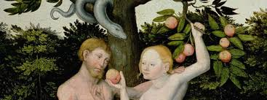
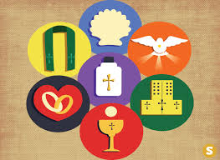
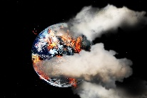
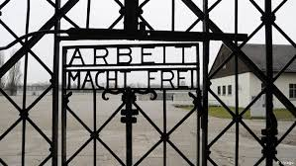
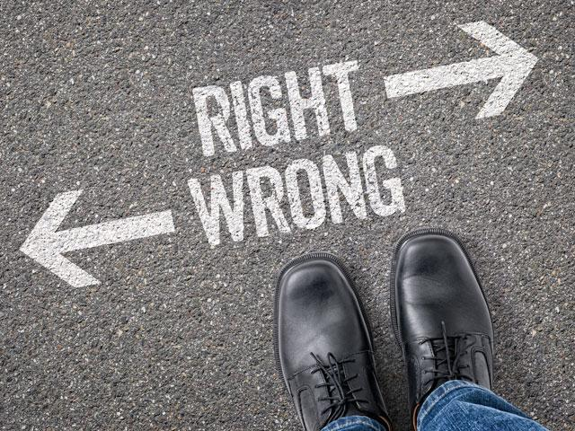
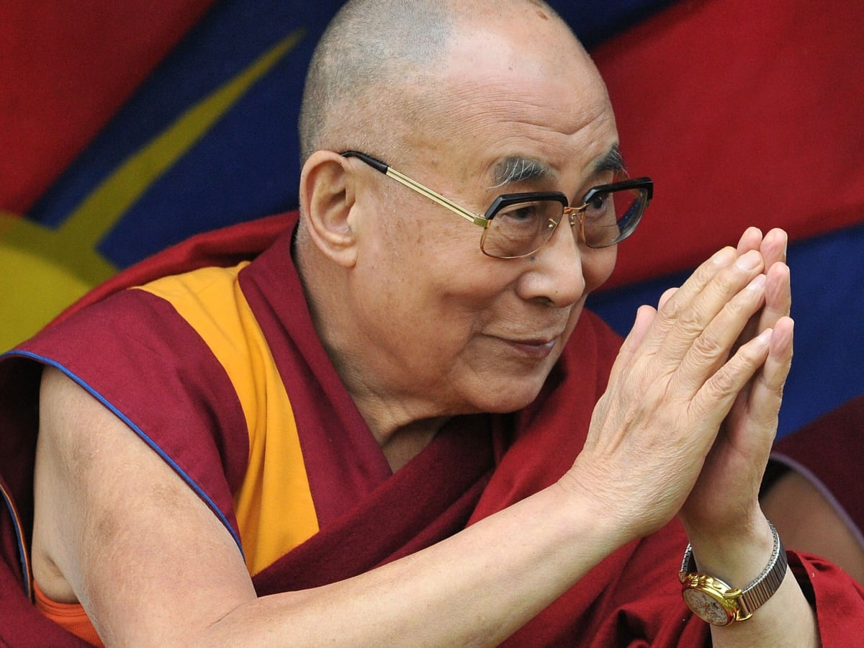
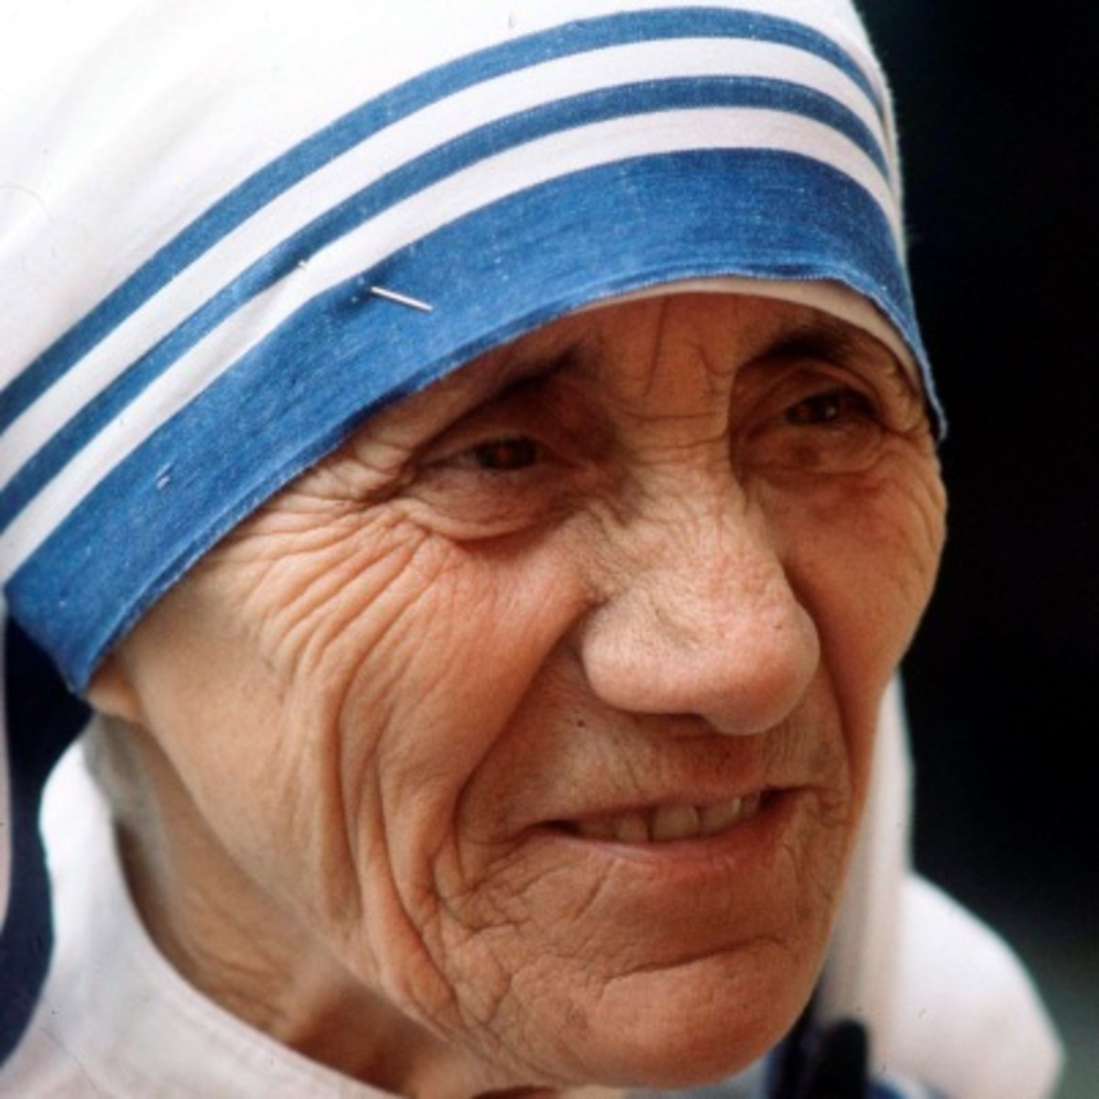
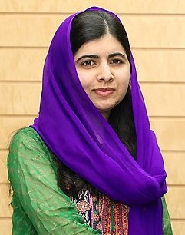

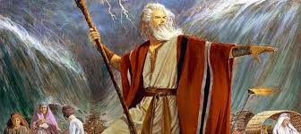
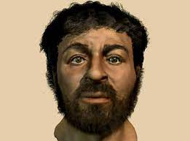
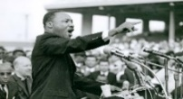

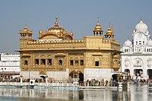

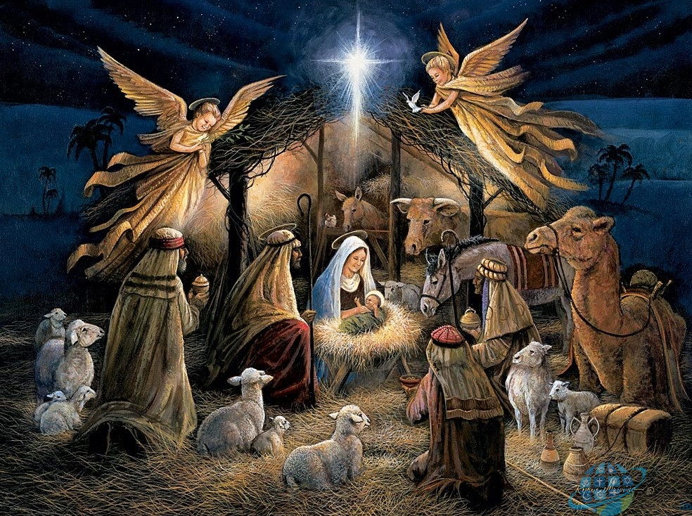



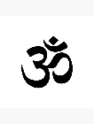
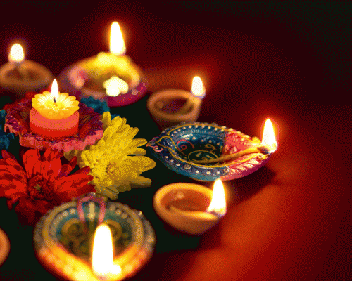

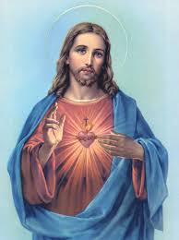

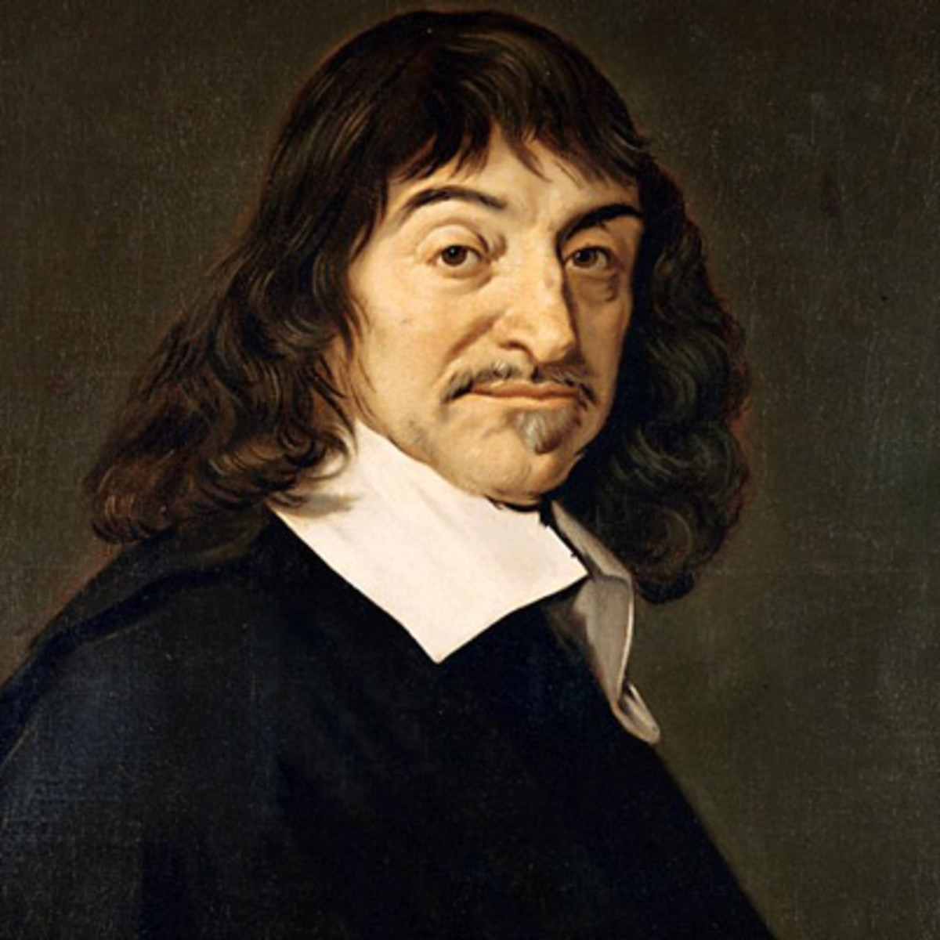


RR
Where are areas of surplus anRd ?A
Reflect…. Revise…. Result…..
Next steps
Justice
Forgiveness
Reconciliation
Death and the afterlife
Religion, Peace and Conflict
Protests and Terrorism
Just War and Holy War
Pacifism and Peace making
Worship and meditation
Vipassana
Samatha
Origins of the universe
Noble Eightfold Path
Ceremonies and rituals
Death and mourning
Abortion and Euthanasia
Buddhism Practices
Mission
Evangelism
Religion and Ethics
Sanctity of Life
Animal Rights
Stewardship
Religion and Life
The five moral precepts
Karma
Karuna
Metta
Buddhism Beliefs and Teachings
The birth of the Buddha and his life of luxury
Suffering
Theravada and Mahayana
11
Contraception and family planning
The four sights
The Sacraments
Festivals
Arhat and Bodhisattva
Foodbanks
Relationships and Families
Marriage and Divorce
Church growth
Christian teachings about human sexuality
Gender Equality
Four Noble Truths
Christianity Practices
Worship and Prayer
The Afterlife and Judgement
Heaven and Hell
Christianity as a world faith
Crucifixion
Resurrection
Ascension
Christianity Beliefs and Teachings
CARES
Can people ever reconcile their differences?
Equality
What is forgiveness?
10
How should criminals be treated?
Experiencing God The oneness of God and the Trinity
The question of God
What are religious attitudes towards the death penalty?
What is the nature of God?
CARES
If God is omnipotent why do people suffer?
Good, bad; right, wrong: how do I decide?
How do religions respond to lawbreakers?
If God exists, why do people suffer?
What is religion?
A-Z
Religion Crime and Punishment GCSE
Punishment or not?
9
CARES
Are some people more equal than others?
Why do we study religion and worldviews?
What is evil and suffering?
Good or bad, The Fall
Why do some people commit crimes?
How do religious beliefs support human rights?
Ambition
Write for Rights
Does God exist?
Death, the end or the beginning?
Should happiness be the purpose of life? Buddhism
What is the history of racism?
Inspirational or not?
Prophets – People of faith
The same, different, respect for all
What is hate crime?
Does the world need prophets today?
Is God the leader?
Authority and Leadership
Good, bad right ,wrong, how do I decide?
Are people born free and equal?
Ambition
How can you change the world?
CARES
What rules for living do we need?
What is prejudice and discrimination?
Is science and religion in conflict?
Reincarnation or not ?
Why do we study religion and worldviews?
YEAR
What do I believe?
Stewardship – The Island
CARES
How can we show the British value of tolerance and respect?
Signs and Symbols
8
How was the world created?
My Life in Pieces
Who am I?
Are we responsible for the world around us?
Are symbols important in our lives?
Can we sense of the world around us?
Where do we come from?
CARES
NATRE
Spirited Arts
Are communities and shared values important in our lives?
Why do we study Religion and Worldviews?
Why are religious festivals important?
Humanism
Hinduism
Islam
CARES
Religious or nor, does it matter?
YEAR
7
Should happiness be the purpose of life?
Sikhism
What are the main religions?
Descartes – Relight the fire
Buddhism Selling Faith
Christianity
Judaism Buddhism
Religion and Worldviews
Community - Ambition –Responsibility- Enriching Curriculum -Self Development

