Slide 1

Wednesday, 18 January 2023
TITLE: THE SIKHI FAITH
Define: Omnipotent | What does Atheist mean?
What does “love thy neighbour mean”? | Who told parables and where can they be found?
What does Agnostic mean? | Unscramble the word below uGru
Does not believe in God or religion
STARTER:
Answer any 5 questions from the grid..
Can you GIVE ME 5?!
All-powerful
Show love and respect to everyone
Jesus and The Bible
Someone who is unsure of God’s existence
Guru

Slide 2
LEARNING OBJECTIVE: To understand the origins of Sikhi Faith and keywords
To identify Sikhi population in U.K
To describe how the Sikhi community express their faith
To explain the Sikhi concepts of belief in God

Slide 3

LEARNING OBJECTIVE 1: To understand key vocabulary and where Sikhism originated
Skills: Explain, Research, Investigate
If you understand these key words NOW, it will help you
all through your RS career
You develop open mindedness by engaging in positive discussion and debate, learning from others and going beyond surface impressions.
Sikhism is one of the youngest religions in the world!

Slide 4
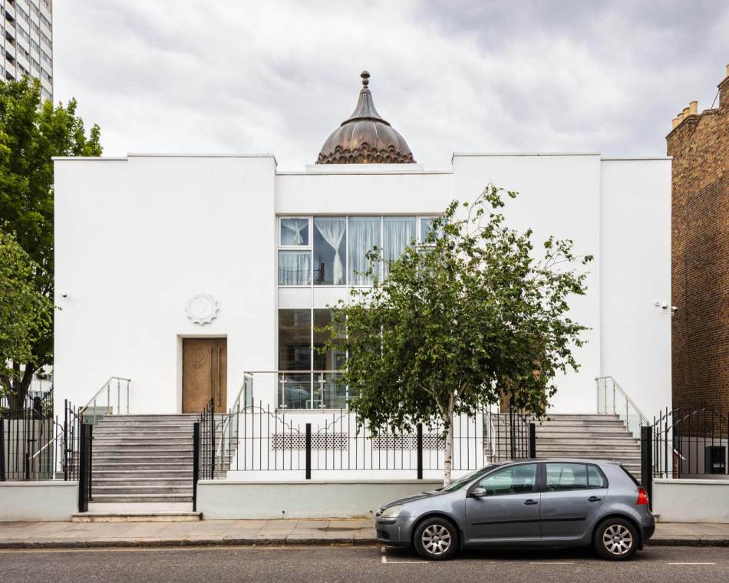
DISCUSS: If you walked past this building, which place of worship do you think you’d be walking past and why?
This is a Sikh place of worship. It is one of the oldest Gurdwaras in the U.K (London)!

Slide 5
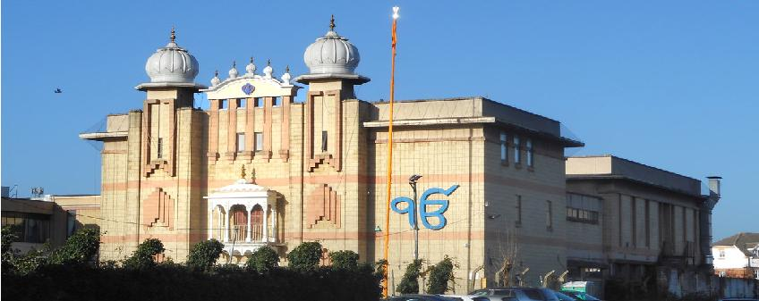
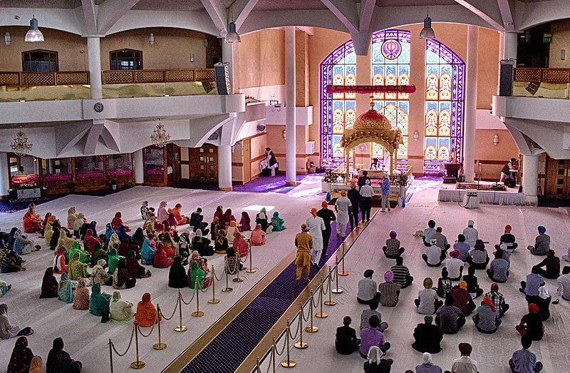
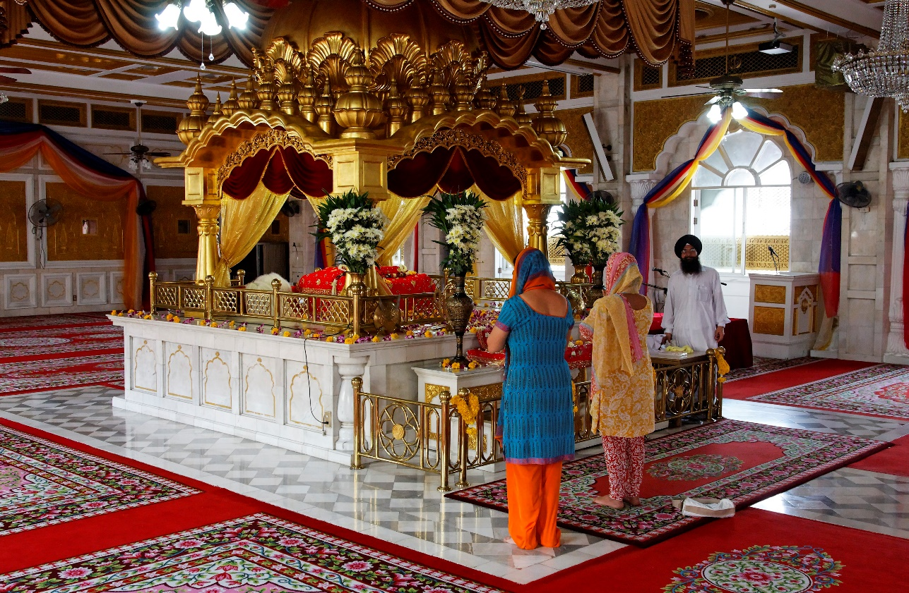
This is now the largest Gurdwara in the U.K which is also based in London and can accommodate up to 3,000 people.
DISCUSS: why might some people disagree with this building being in their community?

Slide 6
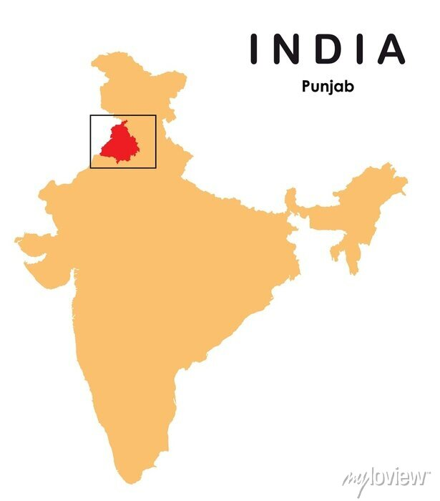
TASK: fill in the gaps to discover where the Sikhi faith began
youngest
Sikhism is the ______________________ of the main world religions.
Sikhism was founded approximately 500 years ago, in ____________________ which is the northwest region of India.
According to a ____________ there are roughly 420,000 Sikhi believers in England, 3000 in Wales, 10,000 in Scotland and 200 in Northern Ireland.
There are ___________________________ Sikhs in the world and 432,000 Sikhi believers live in the UK.
Punjab
survey
30 million

Slide 7
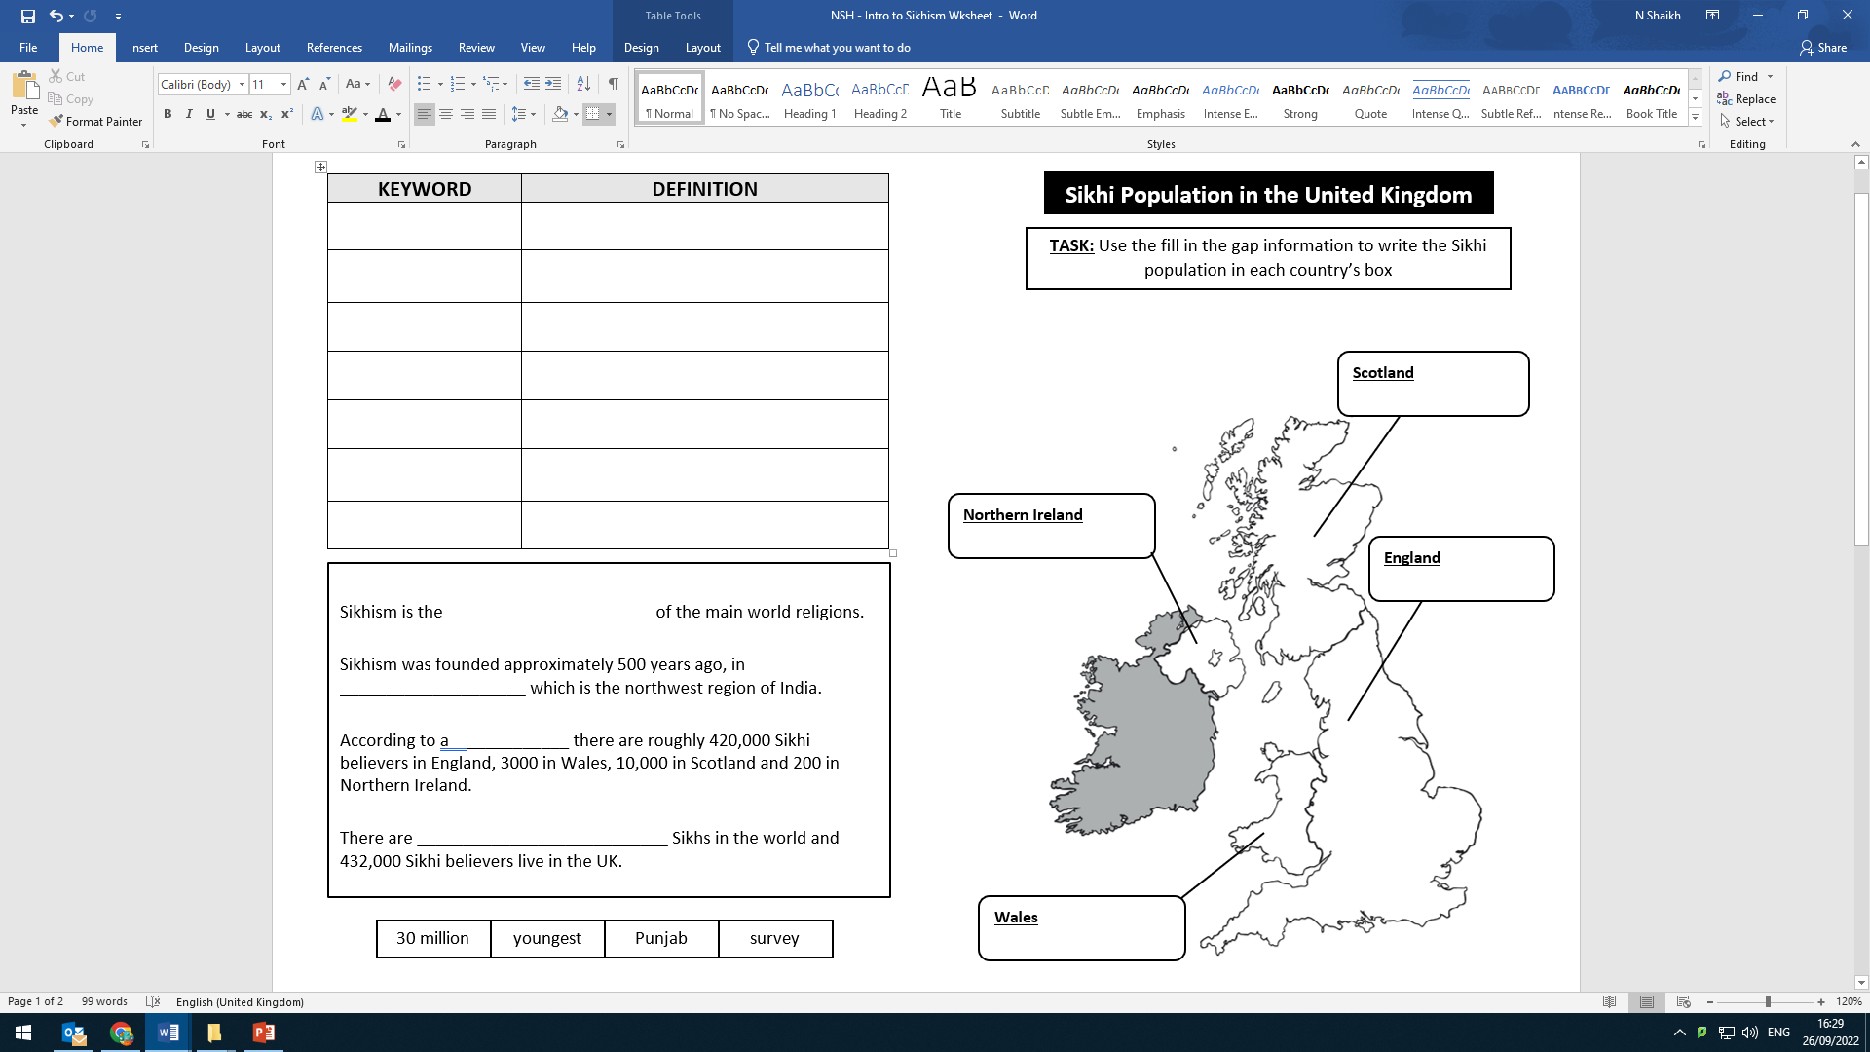

RESEARCH TASK:
Fill in the Sikhi population for England, Scotland, Wales and Northern Ireland.
DISCUSS:
Do any of the statistics surprise you?
STRETCH:
Would the statistics affect how many places of worship there are for Sikhi believers in each country of the U.K?

Slide 8
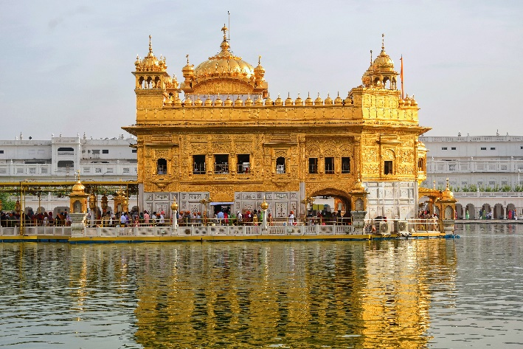
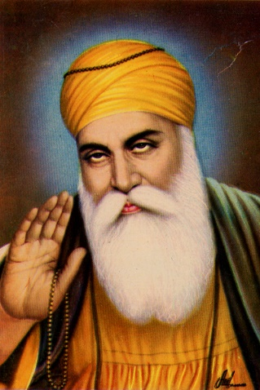
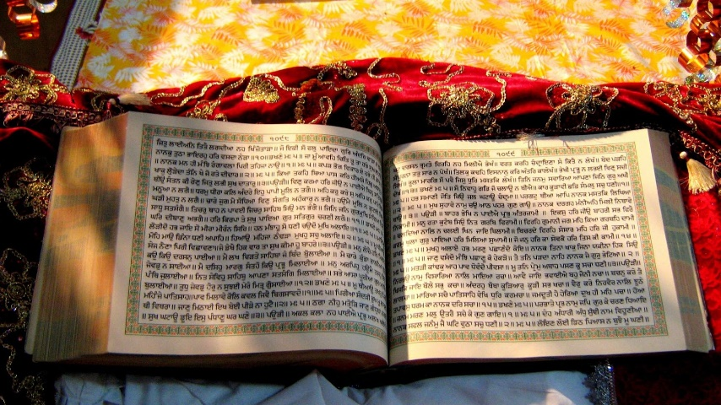
TASK: Your teacher will number you 1-4, answer your question from below in your books by watching the video clip. Then, swap your answers with your group.
https://www.youtube.com/watch?v=qXhV3dMxSzE
Who was the founder of Sikhism?
What is the name for God?
What is the holiest place for Sikh believers?
What is the name of the Sikh Holy Book?

Slide 9
ANSWERS
Who was the founder of Sikhism?
What is the name for God?
What is the holiest place for Sikh believers?
What is the name of the Sikh Holy Book?
Guru Nanak
Waheguru
The Golden Temple
Guru Granth Sahib

Slide 10
Now, match the key terms to the correct definitions and copy into you booklet’s dictionary
Key Term | Definition
Five Ks | Founder of Sikhism
Gurdwara | Sikh name for God
Guru Nanak | Community of Sikhs
Khalsa | Teacher
Waheguru | Symbols worn by Sikhs
Sikhi | Sikh place of worship
Guru | The religion of Sikhism
Sikh | Disciple/learner

Slide 11
TASK: Draw the below spider-diagram in your book. Write your answers underneath your headings
Person
Book
How I express my identity
Object
Clothing
Place

Slide 12
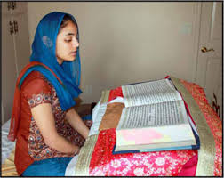
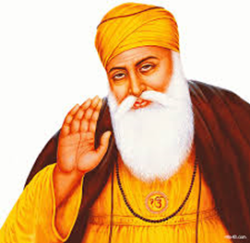
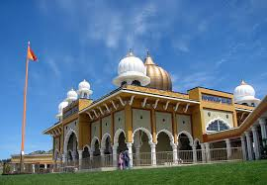
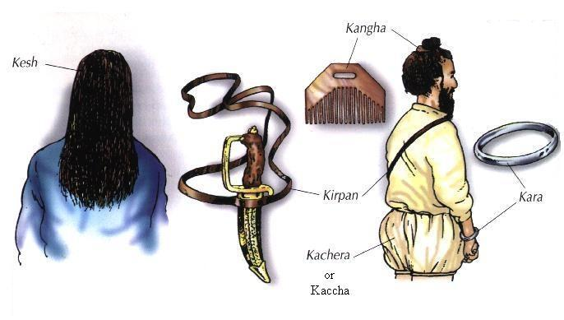
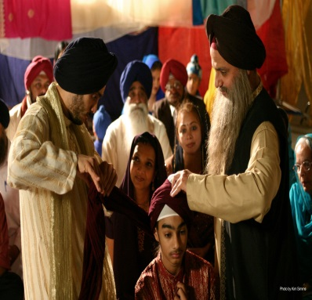
Book
Person
Place
Guru Nanak
Guru Granth Sahib
Expressing Sikhi identity
Gurdwara
Objects
Clothing
Khalsa 5K’S
Turban
https://www.bbc.co.uk/bitesize/topics/zyqnvcw/articles/znpq47h
Notes:
https://www.bbc.co.uk/bitesize/topics/zyqnvcw/articles/znpq47h
- show clip if time permits. Great for Q&A and for misconceptions of the Sikhi faith to be addressed.

Slide 13
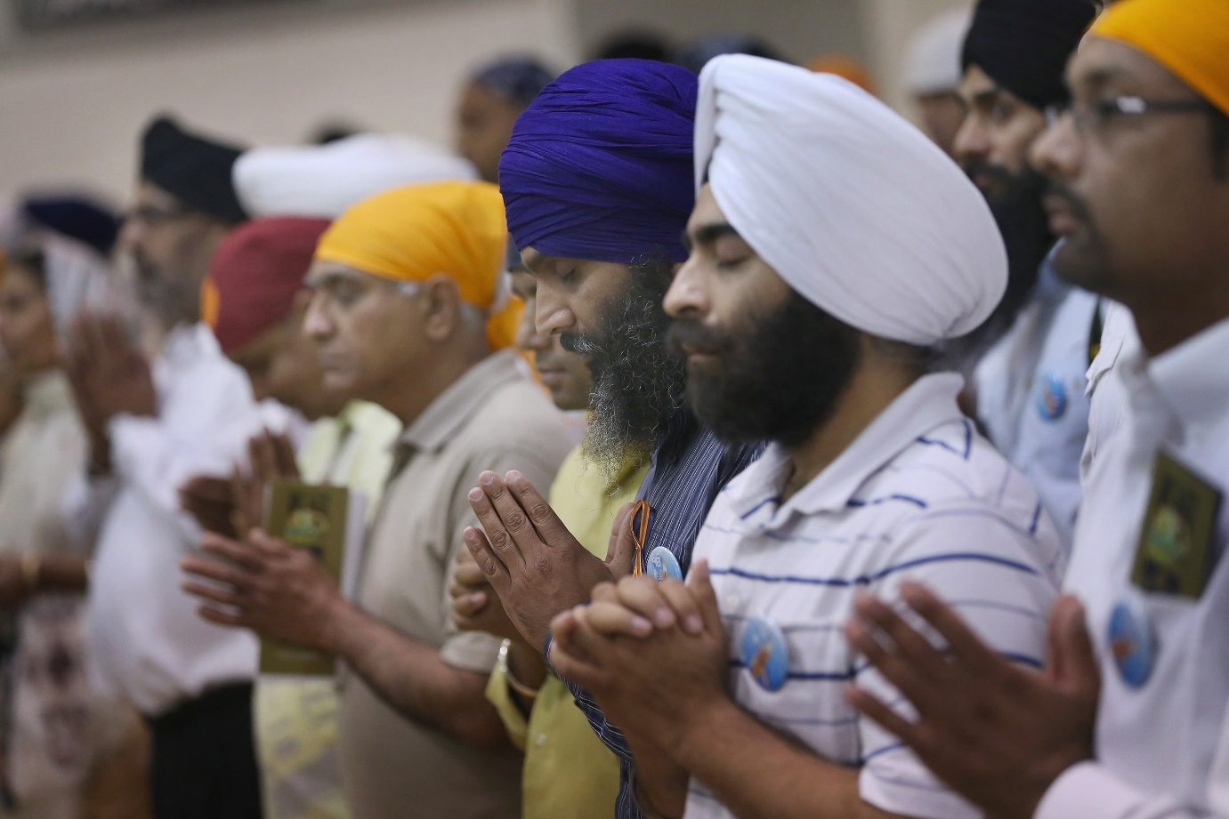
Sikhi beliefs about God
Sikhs believe that:
STRETCH:
If God is always everywhere for Sikhs, how will it influence them to act in their day-to-day lives?
PAIRED TASK:
For each belief create a question where the answer has the be the information in red writing.
There is only one God.
God cannot be described as either male or female.
God created the world and created people to know the difference between right and wrong.
Sikhs do not have images of God and are forbidden to worship any images created of God.
God is both sargun (everywhere and in everything) and nirgun (above and beyond creation).

Slide 14
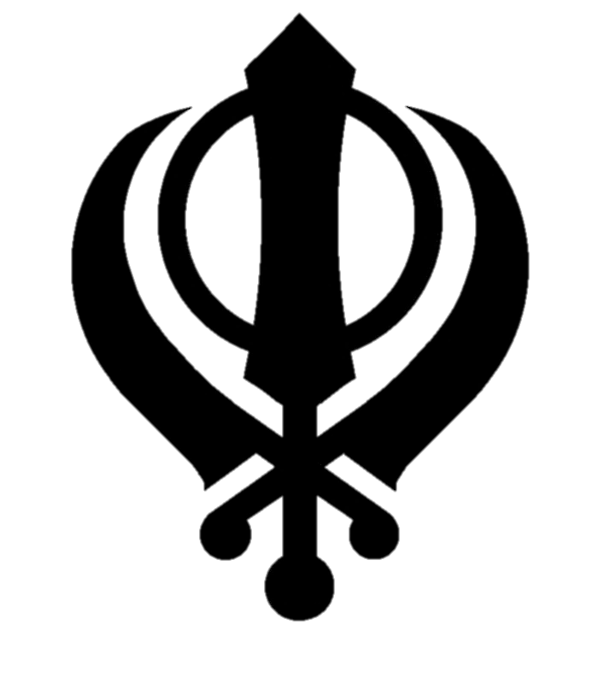
TASKS: Label what each part of the Khanda means
This is the main symbol of Sikhism despite being made up of 4 weapons,
Sikhism is a very peaceful religion and weapons must only
be drawn in self-defence
Khanda Represents fairness of God
Chakka Represents a never-ending powerful God
Kirpan Represents being free to worship God
Kirpan Represents freedom from bad governments

Slide 15
Exit Task
0:59
0:58
0:57
0:56
0:55
0:54
0:53
0:52
0:51
0:50
0:49
0:48
0:47
0:46
0:45
0:44
0:43
0:42
0:41
0:40
0:39
0:38
0:37
0:36
0:35
0:34
0:33
0:32
0:31
0:30
0:29
0:28
0:27
0:26
0:25
0:24
0:23
0:22
0:21
0:20
0:19
0:18
0:17
0:16
0:15
0:14
0:13
0:12
0:11
0:10
0:09
0:08
0:07
0:06
0:05
0:04
0:03
0:02
0:01
Time’s up!
With your partner, list at least 3 facts about the Sikhi Faith from today’s lesson
Start

