Slide 1

TITLE: How did Martin Luther King challenge racism?
1. Who was Nicky Cruz? | 2. What does discrimination mean? | 3. What is justice?
4. Prejudice means? | 5. Give at least two Christian beliefs. | 6. What might a Christian use to guide them in their lives?
Notes:
3 poisons: ignorance, greed and desire, anger and hatred
Ignorance = pig
Greed = cockerel
Anger = snake

Slide 2

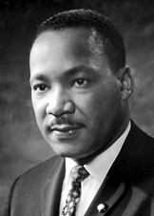
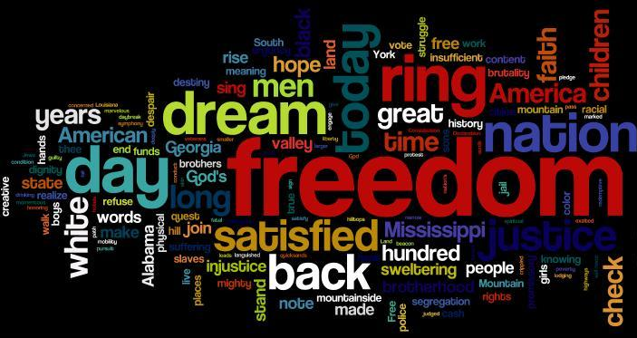
TITLE: How did Martin Luther King challenge racism?
Tasks:
1. What are the biggest 5 words in this wordle?
2. Why are some words larger than others?
3. What places can you see in the wordle? STRETCH: what else do you know about MLK? Can you add more words that should be in the wordle?

Slide 3
The BIG question: How did Martin Luther King challenge racism?
Keywords:
Racism
Civil Rights
Segregation
Explain the actions of Martin Luther King Jr.
Explore how faith and belief affected and inspired Martin Luther King’s life and actions.
Consider ways to fight injustice.

Slide 4
Keyword peer check task
TASK 1: THINK - 1 minute to think and write your definition of the word ‘segregation’.
TASK 2: PEER CHECK - Swap books with your partner. Mark your partners answer:
0= No match 1=partly matches 2= matches the definition
Segregation: the separation of people into racial groups (skin colour) in daily life. For example, separate eating areas in a restaurant, drinking from a separate water fountains, attending separate schools or riding on the back of a bus.

Slide 5

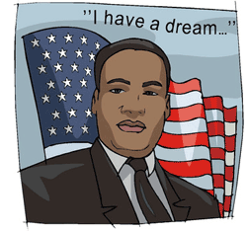
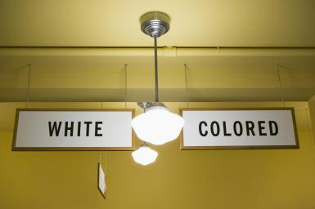
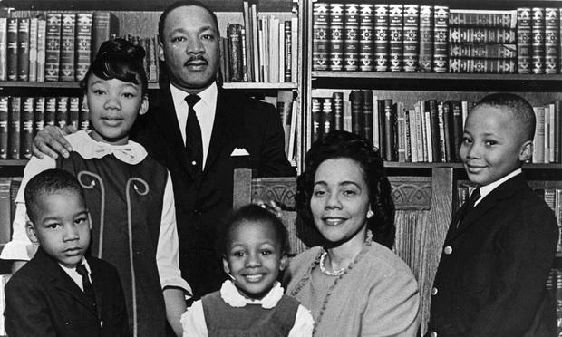
Setting the scene
TASK 1: Read page 1 of the information sheet together.
TASK 2: Highlight any key words you don’t know the meaning of.
TASK 3: Who was Martin Luther King Jr. inspired by?
TASK 4: What were freedom rides?
STRETCH: How would you bring about change for something that you felt was unjust?

Slide 6
What religion was MLK?
Christian
Christians believe that all people are equal no matter what the colour of their skin is, no matter what their gender is.
In the Bible is teaches: “There is neither Jew nor Gentile, neither slave nor free, nor is there male and female, for you are all one in Christ Jesus.” Galations 3:28
How might a Christian use this quote to guide their opinions and treatment of other people?

Slide 7
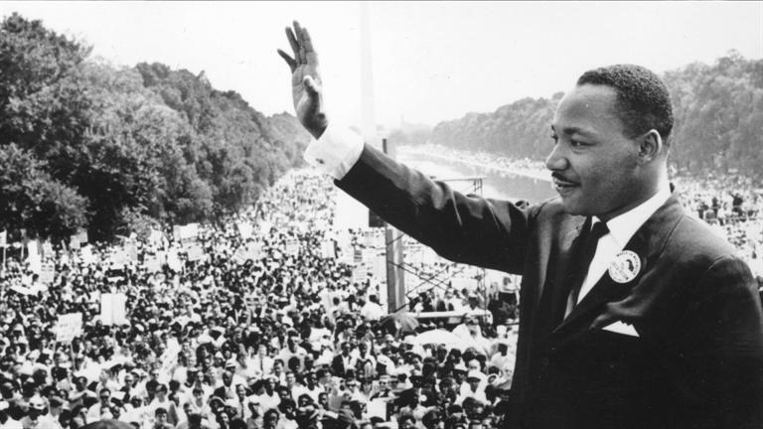
Historical blog
Blog activity:
You are going to create a blog based on MLK.
You must include information about the peaceful protests, marches and the Civil Rights Act.
Write a large paragraph.
TIP: Use the knowledge organiser to help you write your blog/paragraph.
STRETCH: What new laws would you bring into this country to support equality and fight injustice?

Slide 8
Self Assessment
Can you show an understanding of MLK’s views and fights for injustice?
Did you begin to explain examples, including protests, marches and civil rights acts?
Did you reflect on MLK’s work and link it to your own life and viewpoints?
How successful have you been today?

Slide 9

‘MLK will always
be remembered.’
Do you agree with this quote?

